Slide 1

CSE-5335-005: WEB DATA MANAGEMENT
Final Demo and Presentation
Website Name- ScholarVault
Cloud Link- https://sxb3349.uta.cloud/
TEAM-1
Sanketh Bolishetti (1002144534)
Pradeep Akula (1002140196)
Soumya Reddy Bheemreddy (1002193346)
Kintur Ketan Shah (1002178072)
Kausheel Bhagavathula (1002118457)
Madhupriya Bendili (1002124302)

Slide 2

Project Name- Digital Thesis Repository
- The Digital Thesis Repository is a centralized platform designed to store and showcase academic thesis and dissertations.
- It features a user-friendly interface that allows users to search scholarly content using filters such as topic, author, year, and keywords.
- The platform fosters academic collaboration by enabling peer review and community feedback, ensuring submission consistency through clear guidelines.
- Additionally, it provides statistical insights, including thesis views and download metrics, to help understand content popularity and user engagement. This repository serves as a valuable resource for students, researchers, and educators, promoting knowledge sharing and academic excellence.

Slide 3
- The primary objectives of these project are:
Central Repository: Create a secure, centralized platform for storing and displaying academic theses and dissertations.
User-Friendly Search: Design an intuitive search function that allows users to efficiently find academic work using filters such as topic, author, year, and keywords.
Community Engagement: Enable peer review and academic dialogue through built-in feedback and commenting features to encourage scholarly collaboration.
Submission Guidelines: Provide standardized templates and submission instructions to maintain consistency and academic standards.
Statistical Insights: Offer detailed analytics on thesis views, downloads, and overall popularity to help track academic trends and user engagement.

Slide 4
Key Features
Advanced Search Options:
Filters like topic, author, year, keywords, and institution.
Full-text search for enhanced discoverability.
Peer Review:
Enables academic collaboration through comments.
Fosters a constructive review process for quality assurance.
User Access Levels:
Role-based access for students, scholars, and administrators.
Secure login and user account management.
Content Analytics:
Displays key insights such as thesis views, downloads, and user engagement statistics in an interactive dashboard.
Tracks user behavior to identify trending research areas.
Real-Time Chat Feature:
Enables real-time messaging between users, scholars, and administrators.
Scholars and users can discuss research topics and ideas collaboratively.

Slide 5
Team Member Contributions to Project Development
Madhupriya: Responsible for the Home page, About Us section, and the search functionality.
Kintur: Worked on the Contact Us page, as well as the login and signup features.
Pradeep: Focused on developing the Dashboard and the All Thesis section.
Kausheel: Managed the guidelines and user management tasks.
Soumya: Handled the management of reviews, thesis, and thesis submissions.
Sanketh: Worked on the profile page, notifications, and chat functionality.

Slide 6
Overview
The Navigation Bar of our website contains following pages:
1. Home
2. About Us
3. Search
4. Blogs
5. Contact Us and
6. Login/Sign Up
These are the pages which helps to navigate the basic overview of our website and
gives the end user an overall view.
These menu items are essential for improving user experience (UX) by allowing users
to navigate a website quickly and efficiently.

Slide 7
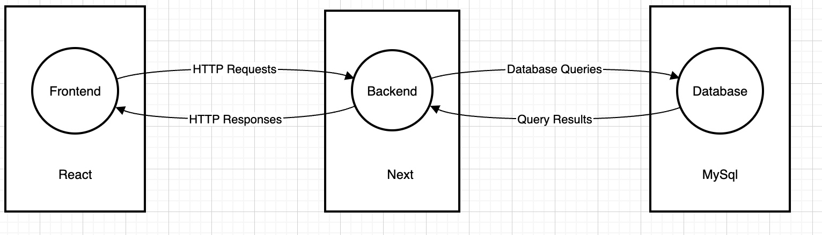



Technologies Used

Slide 8

PHASE 4 Demo

Slide 9
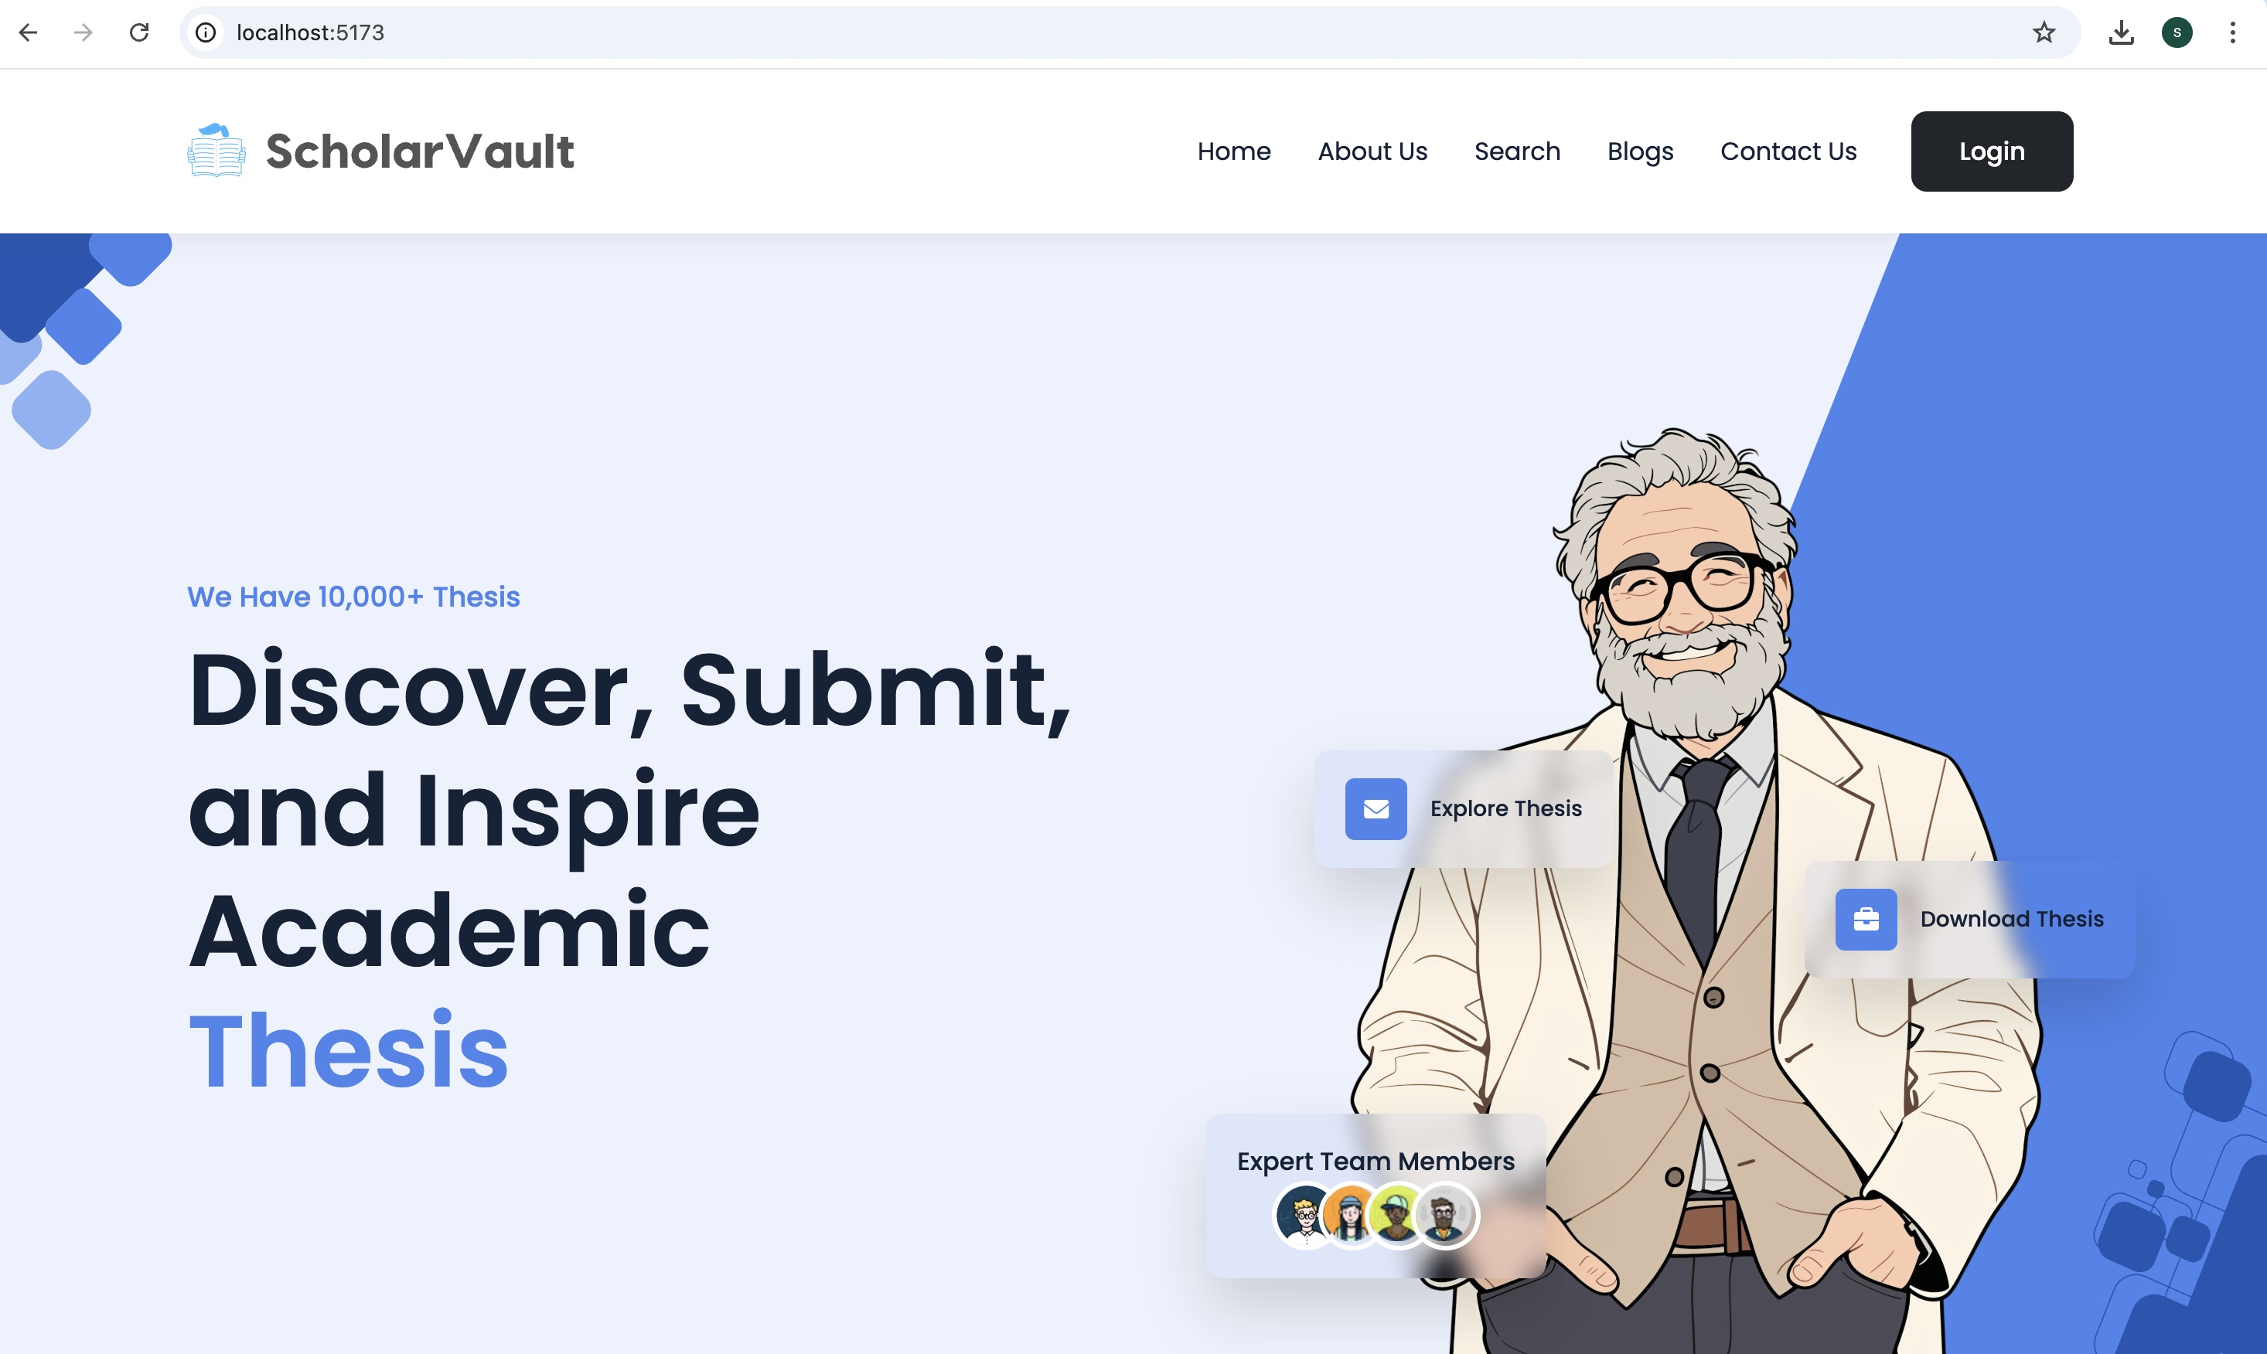
HOME PAGE

Slide 10
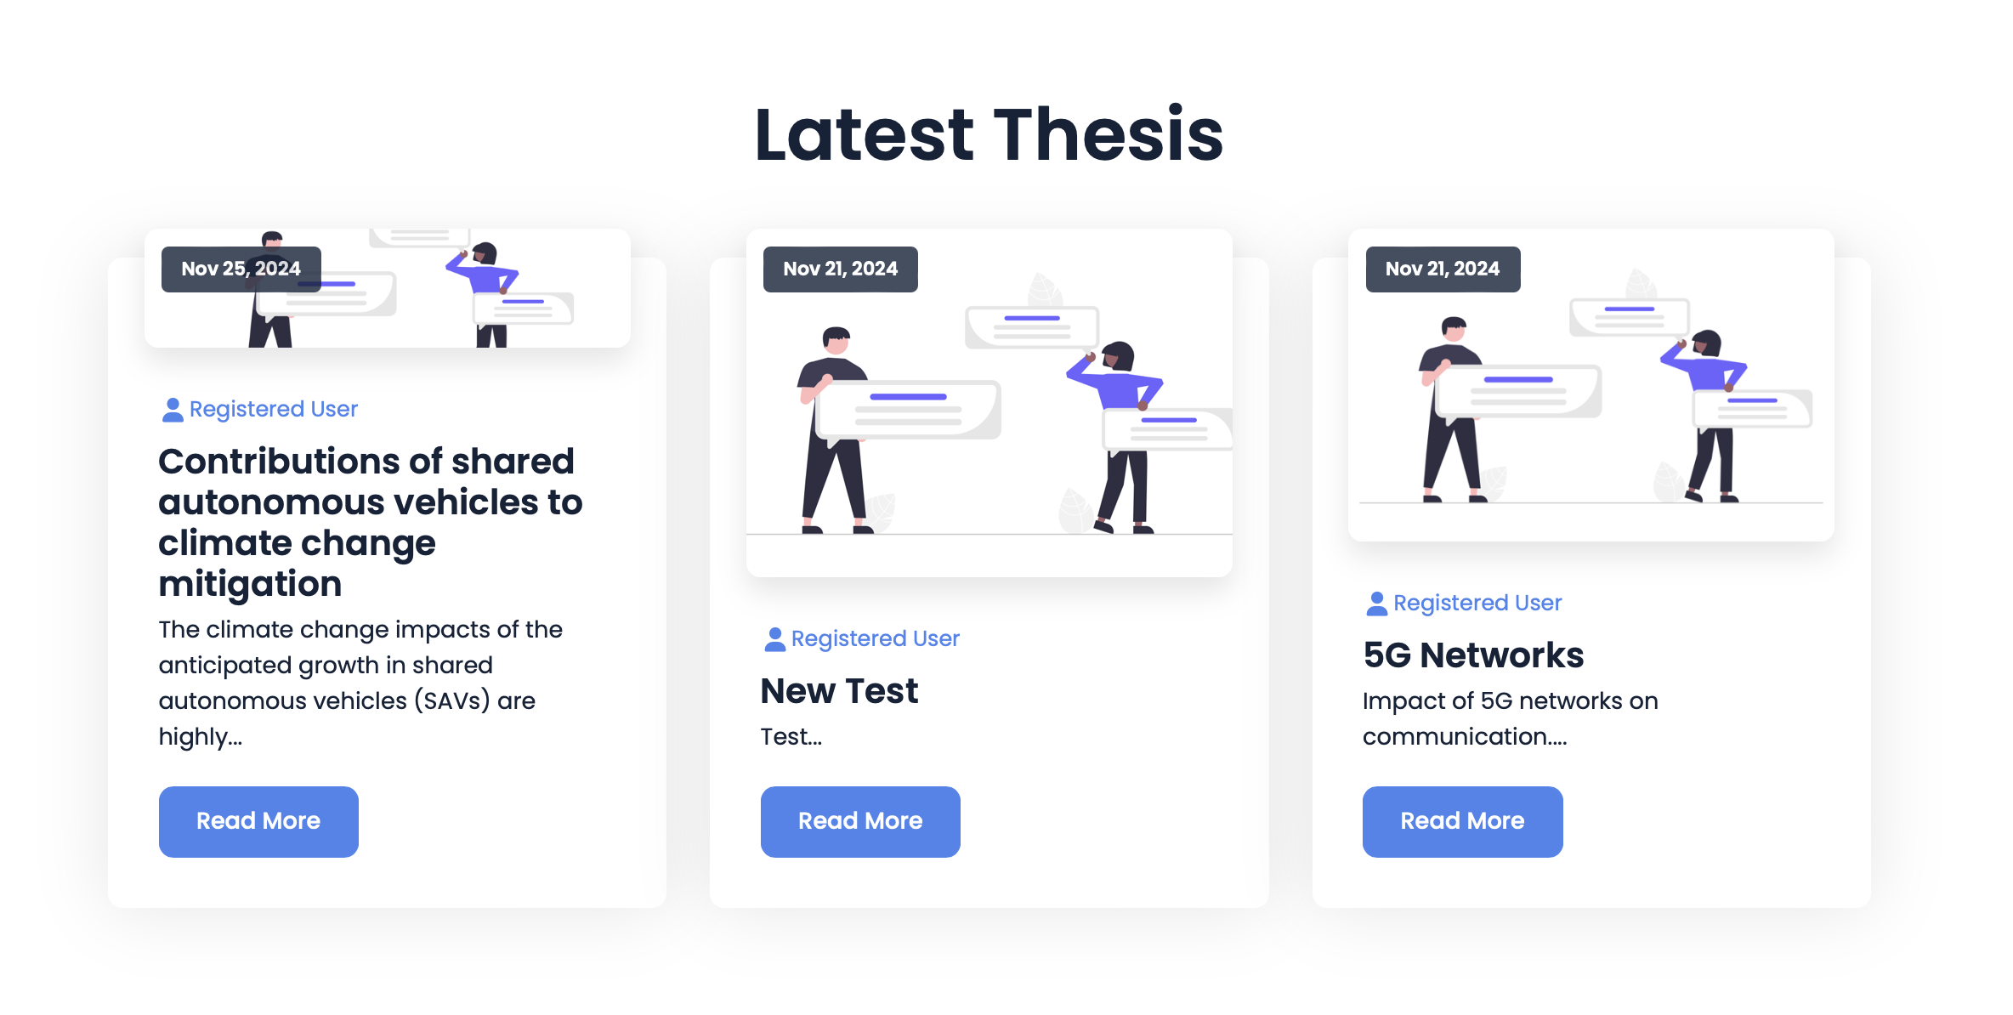
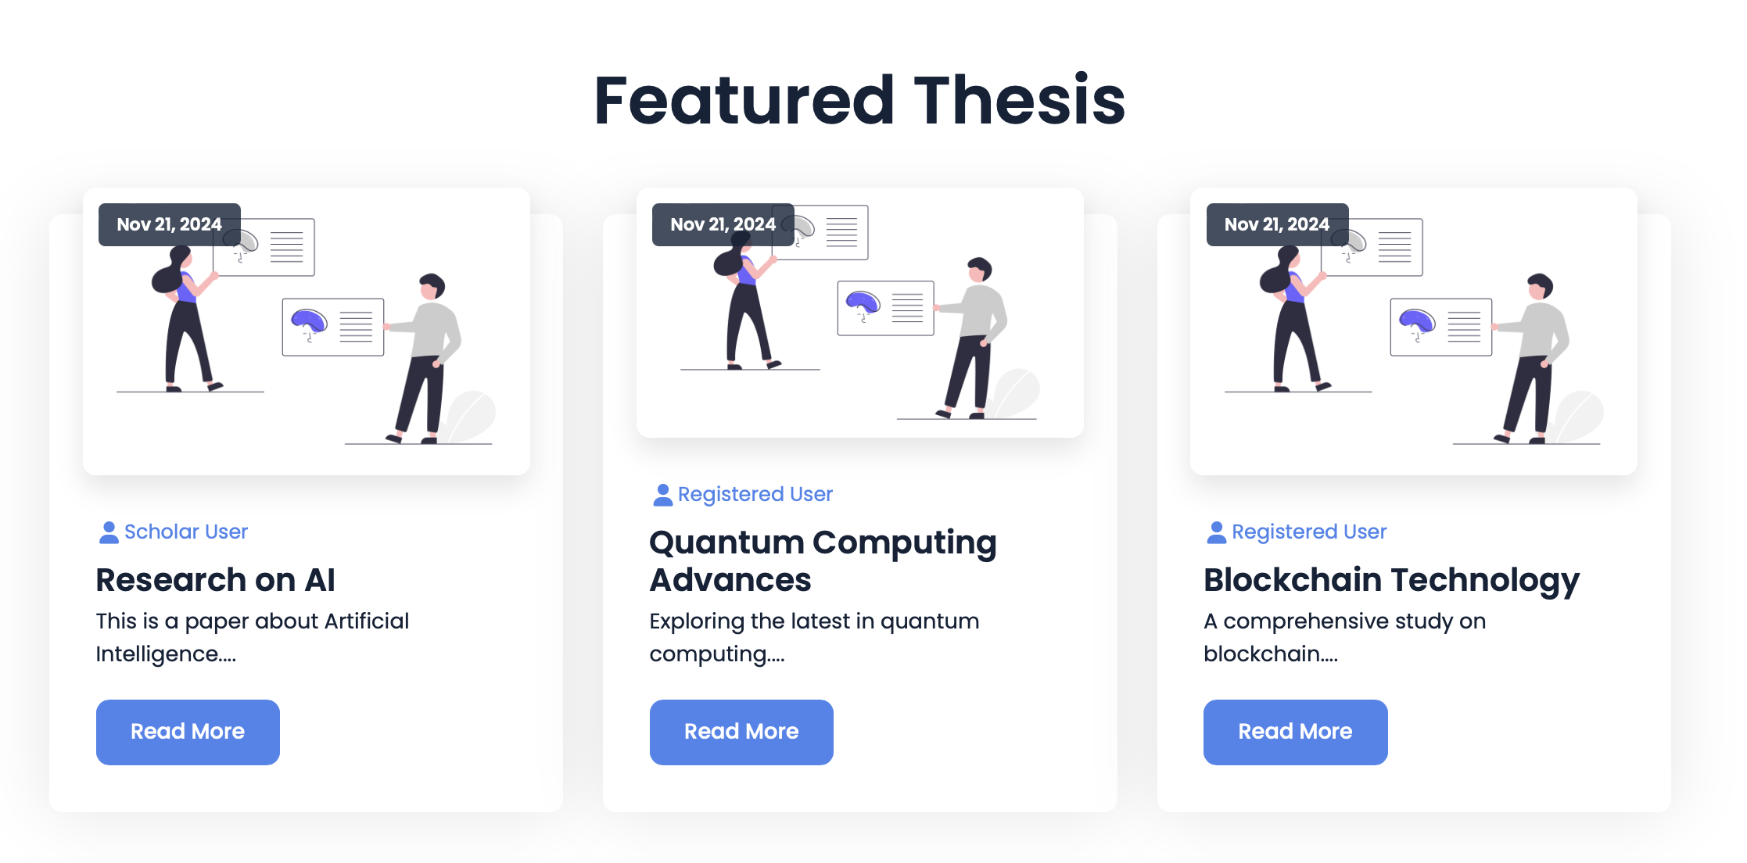

Slide 11
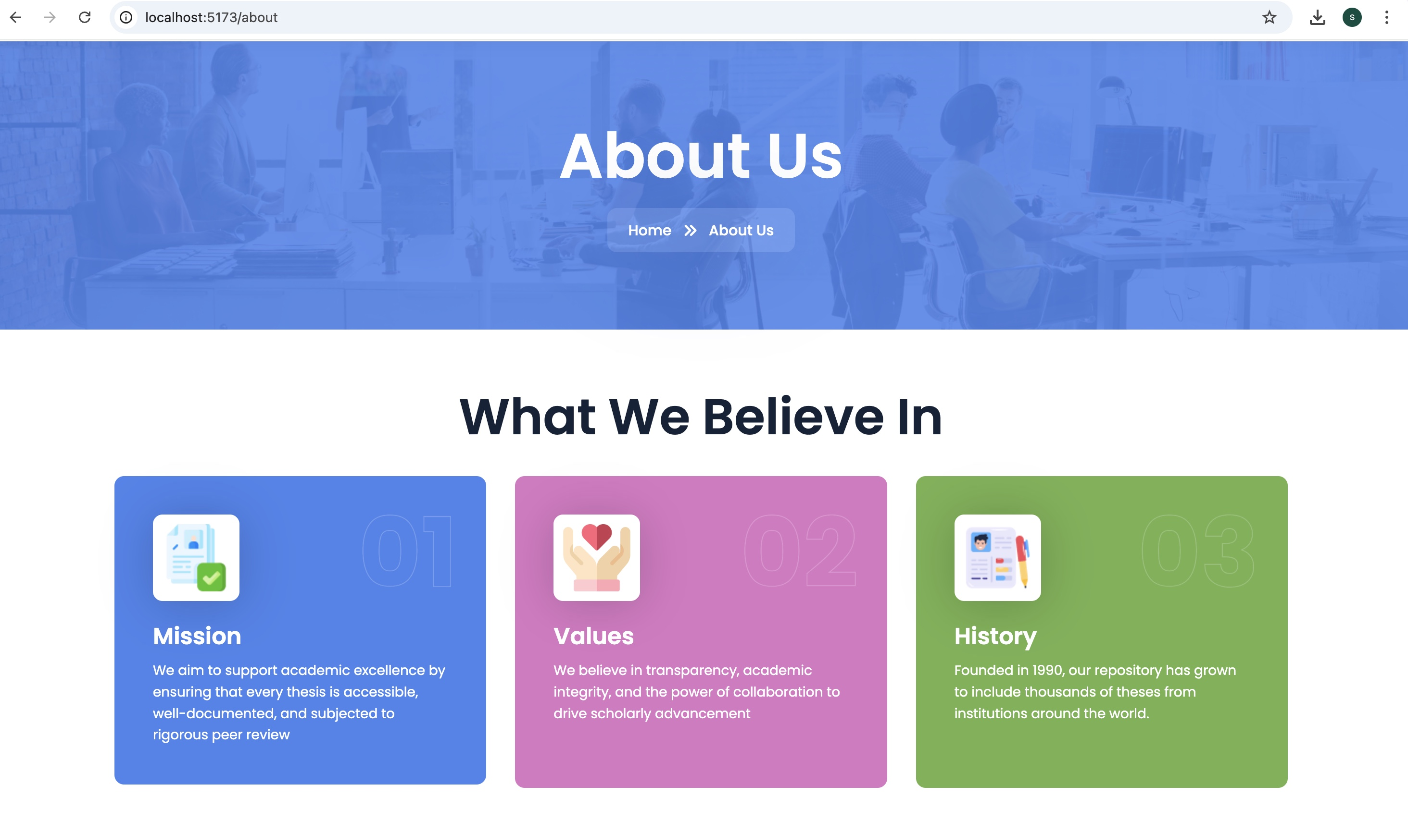
ABOUT US

Slide 12
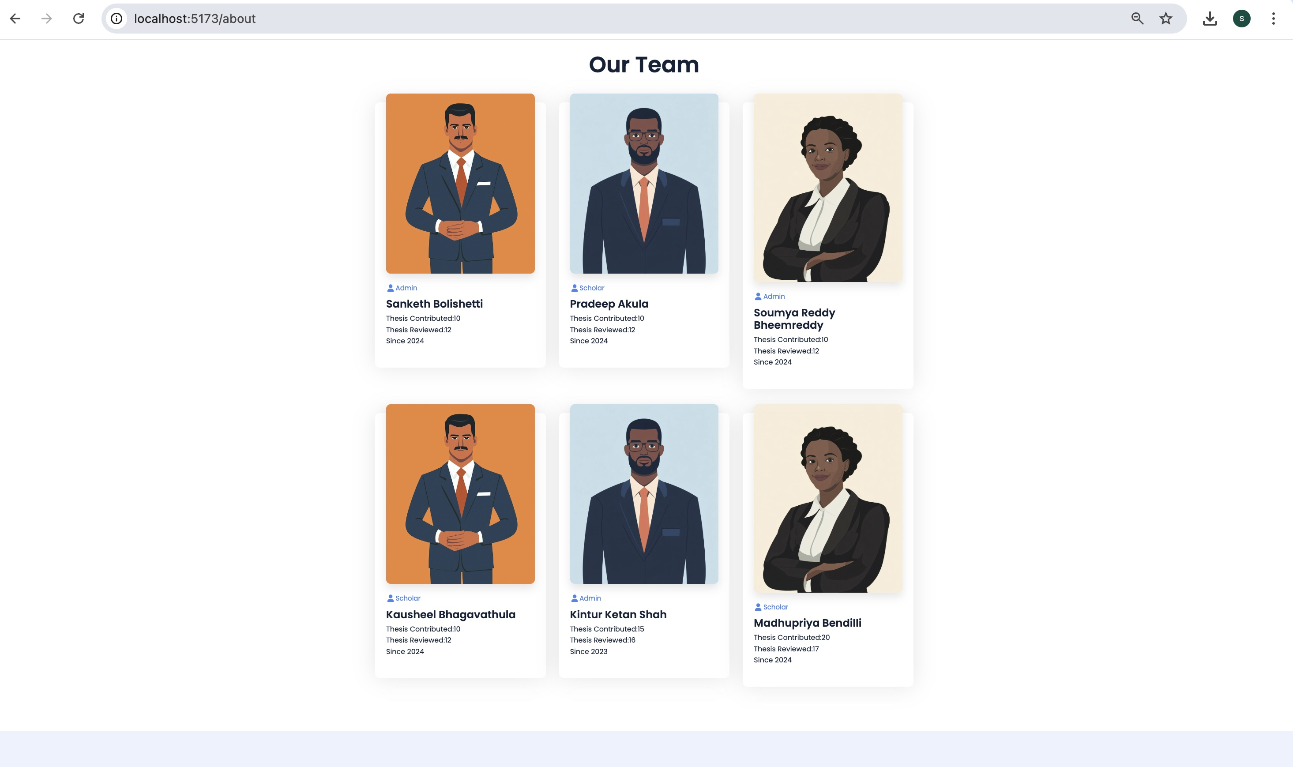

Slide 13
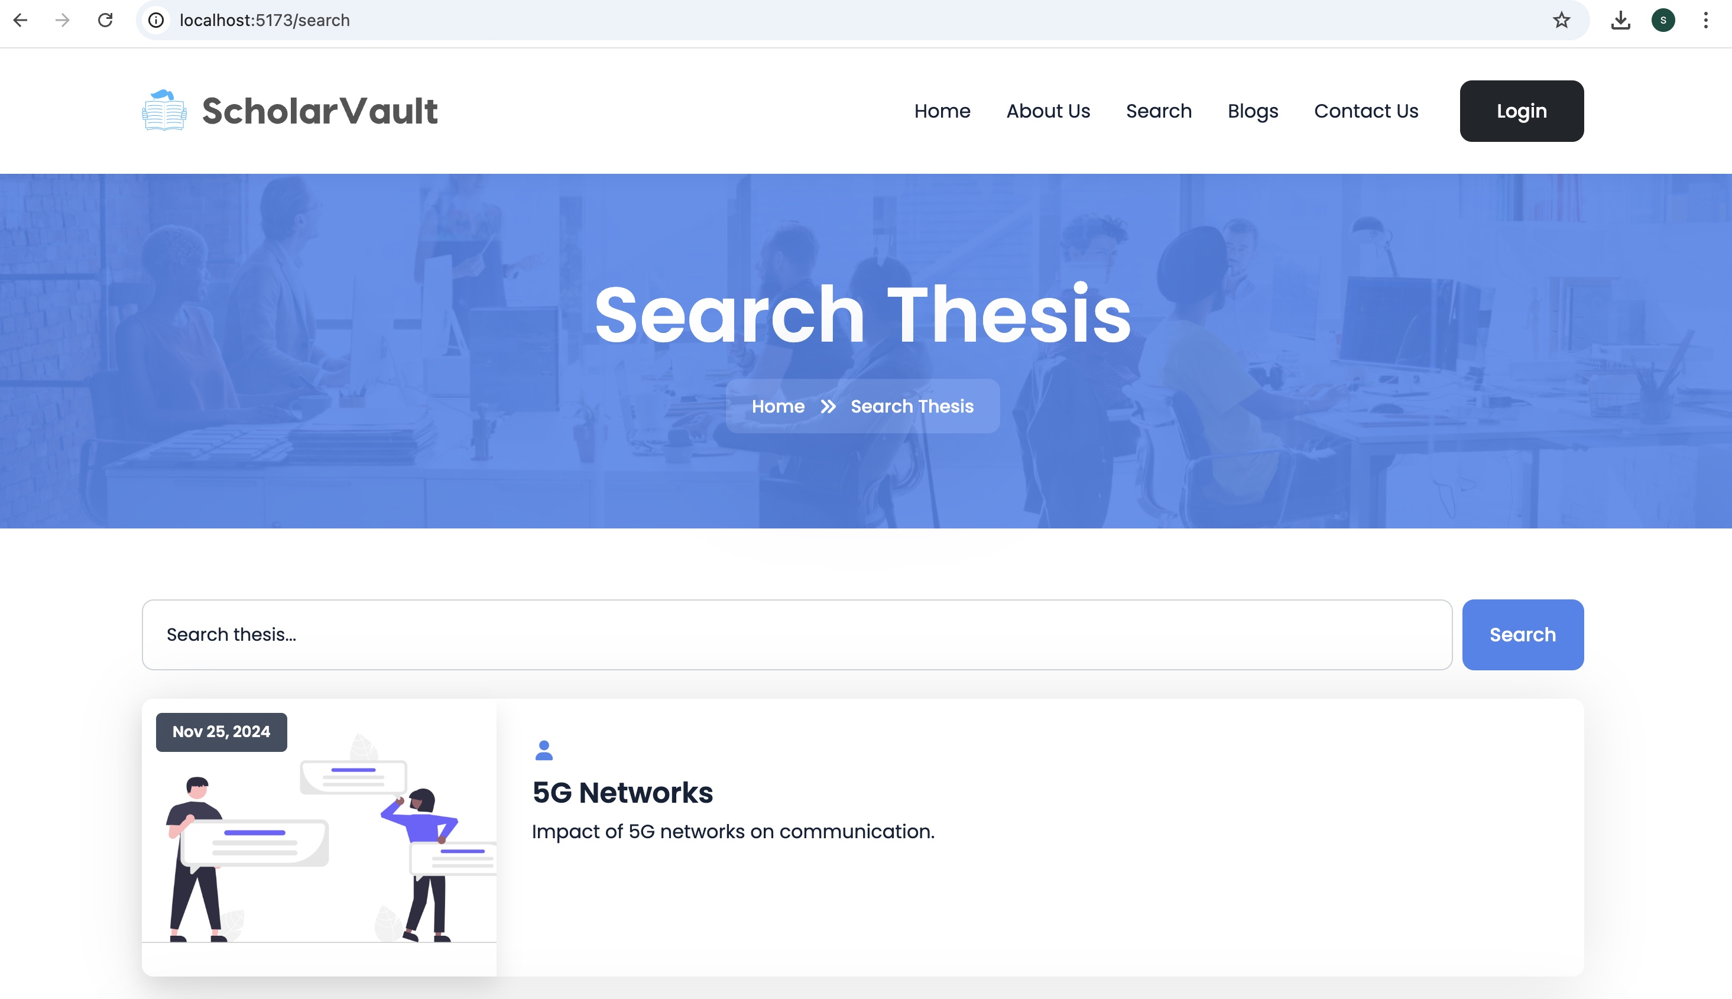
SEARCH PAGE

Slide 14
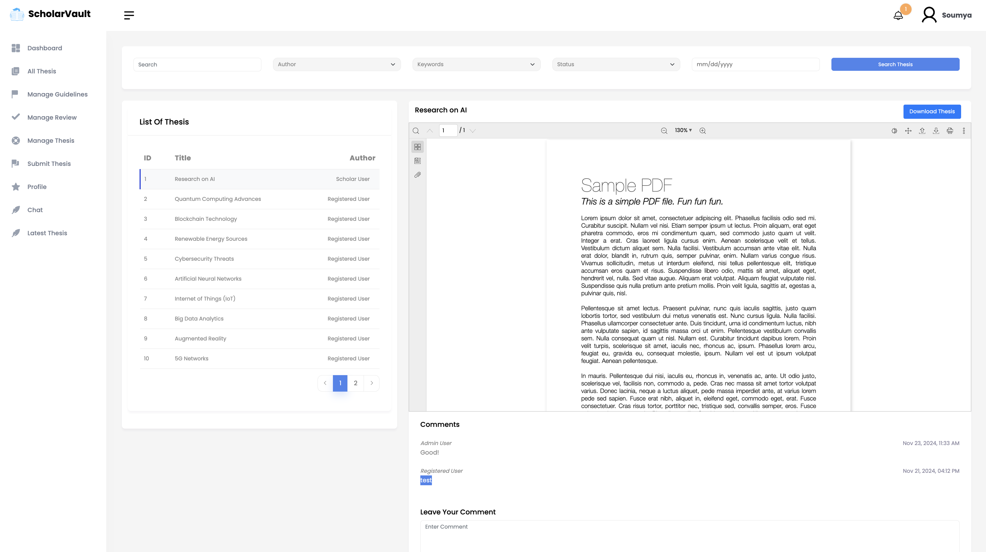

Slide 15
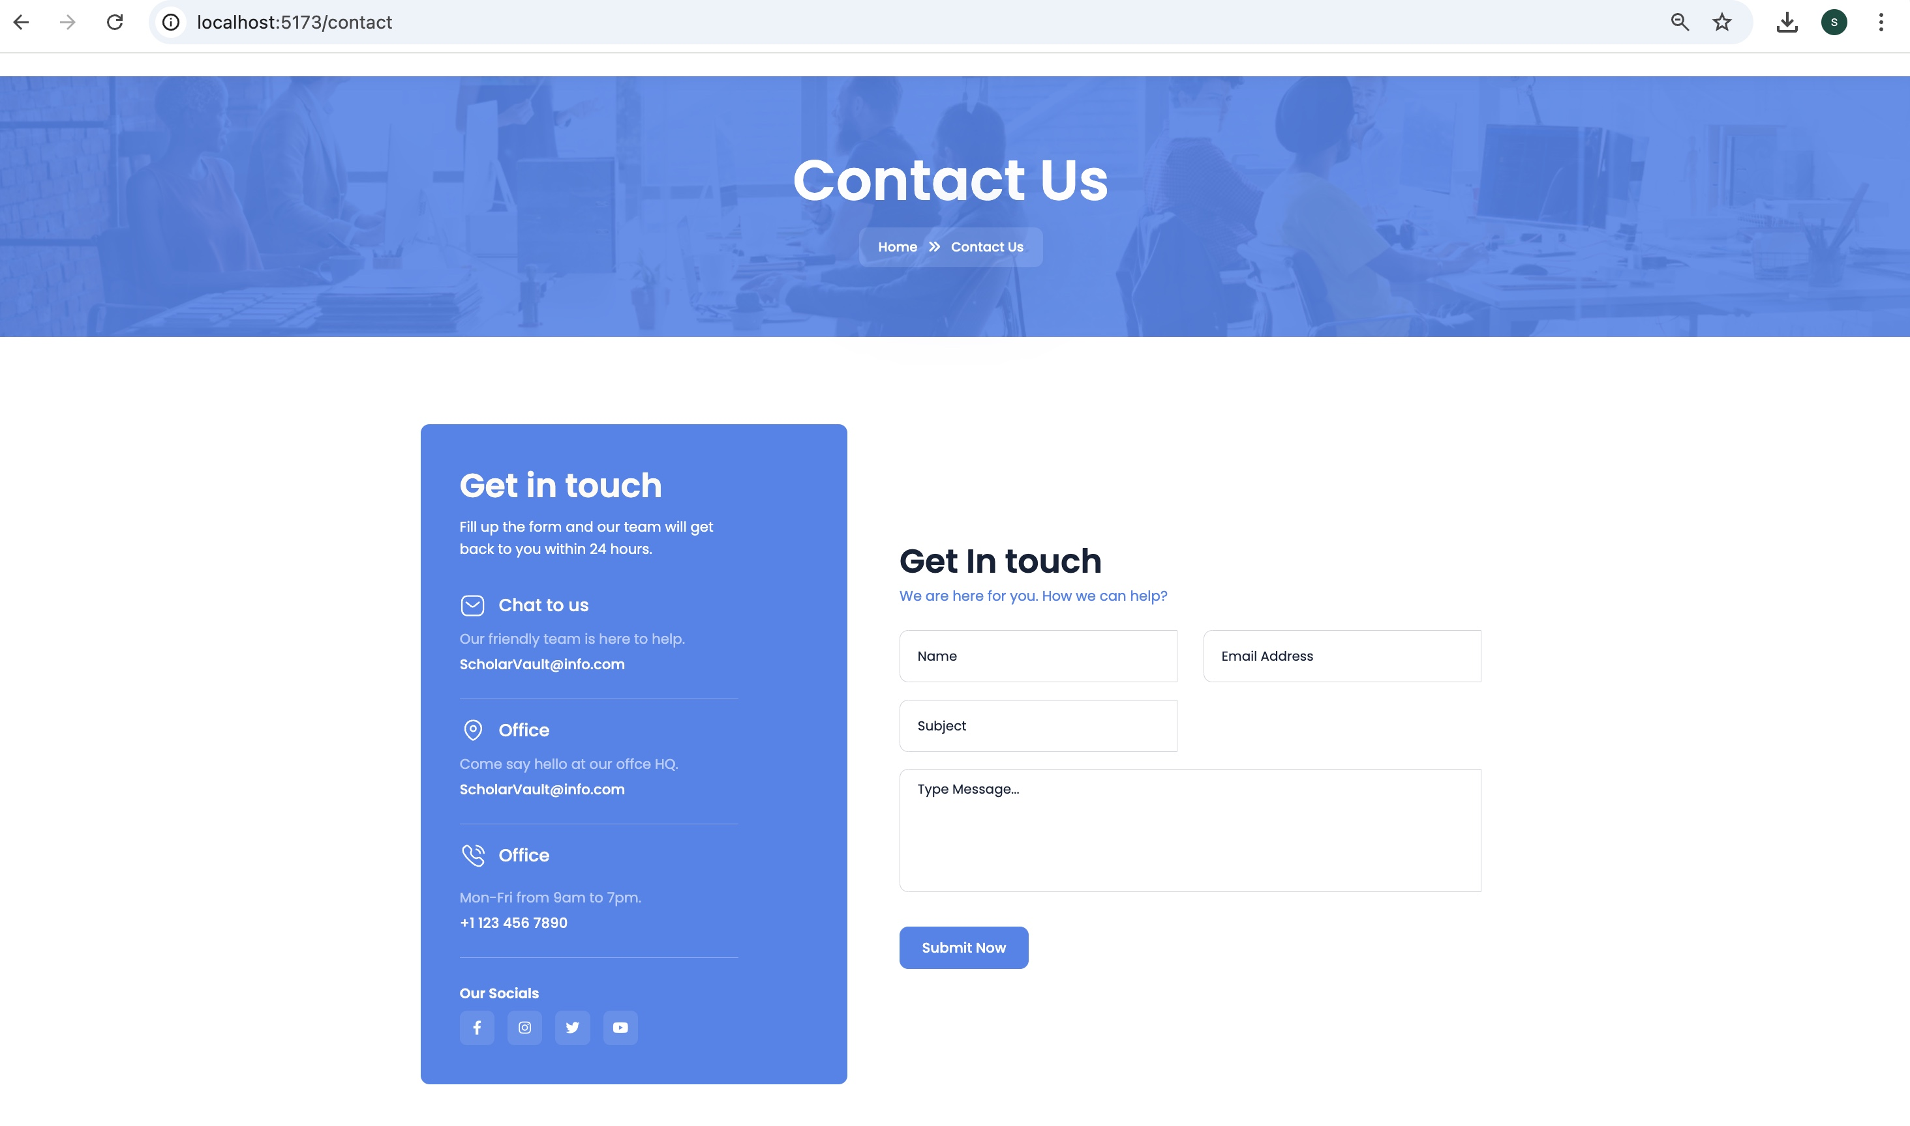
CONTACT US

Slide 16
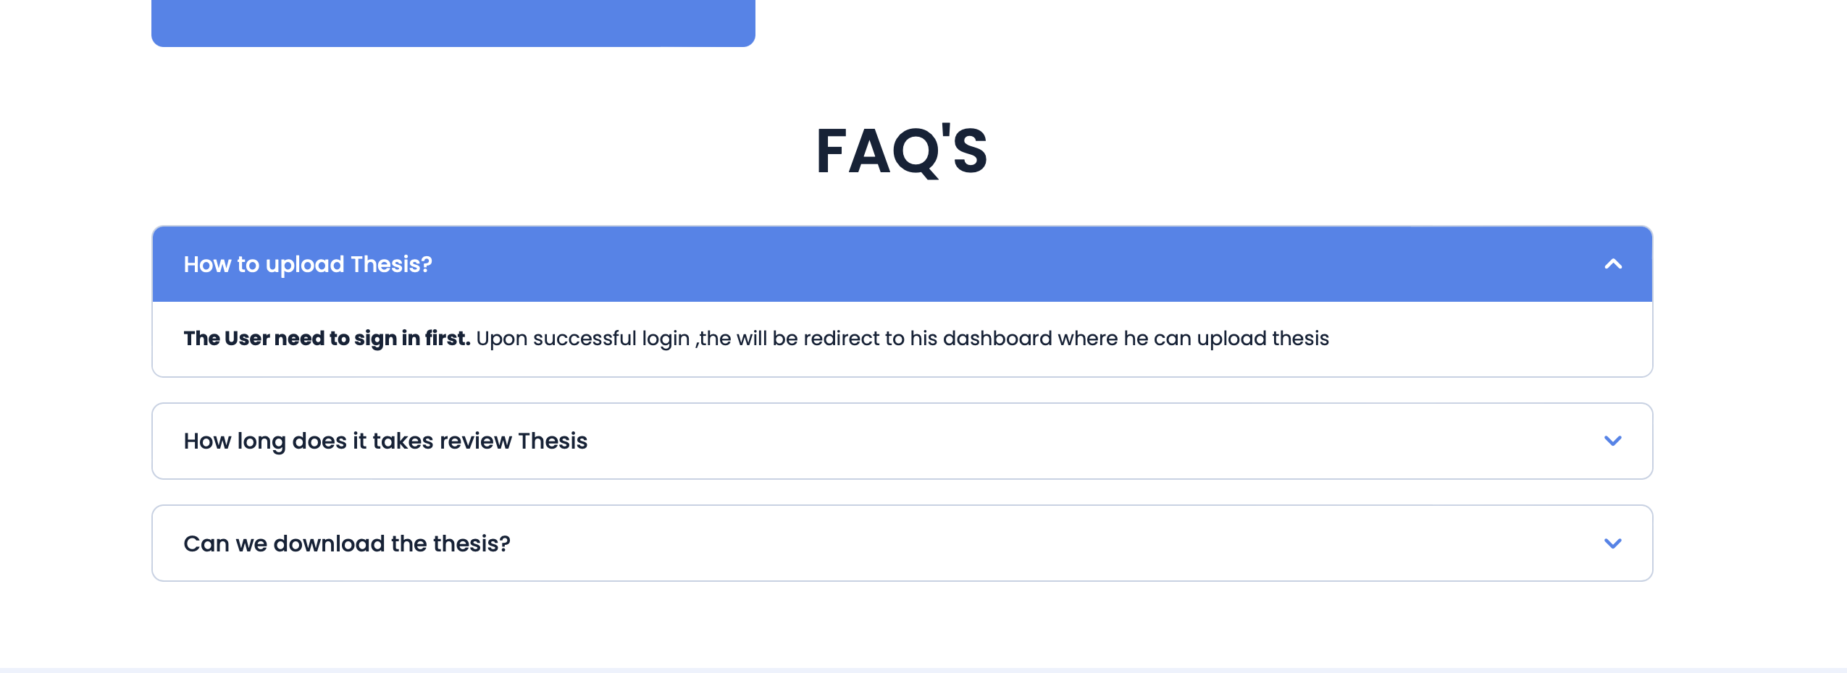

Slide 17
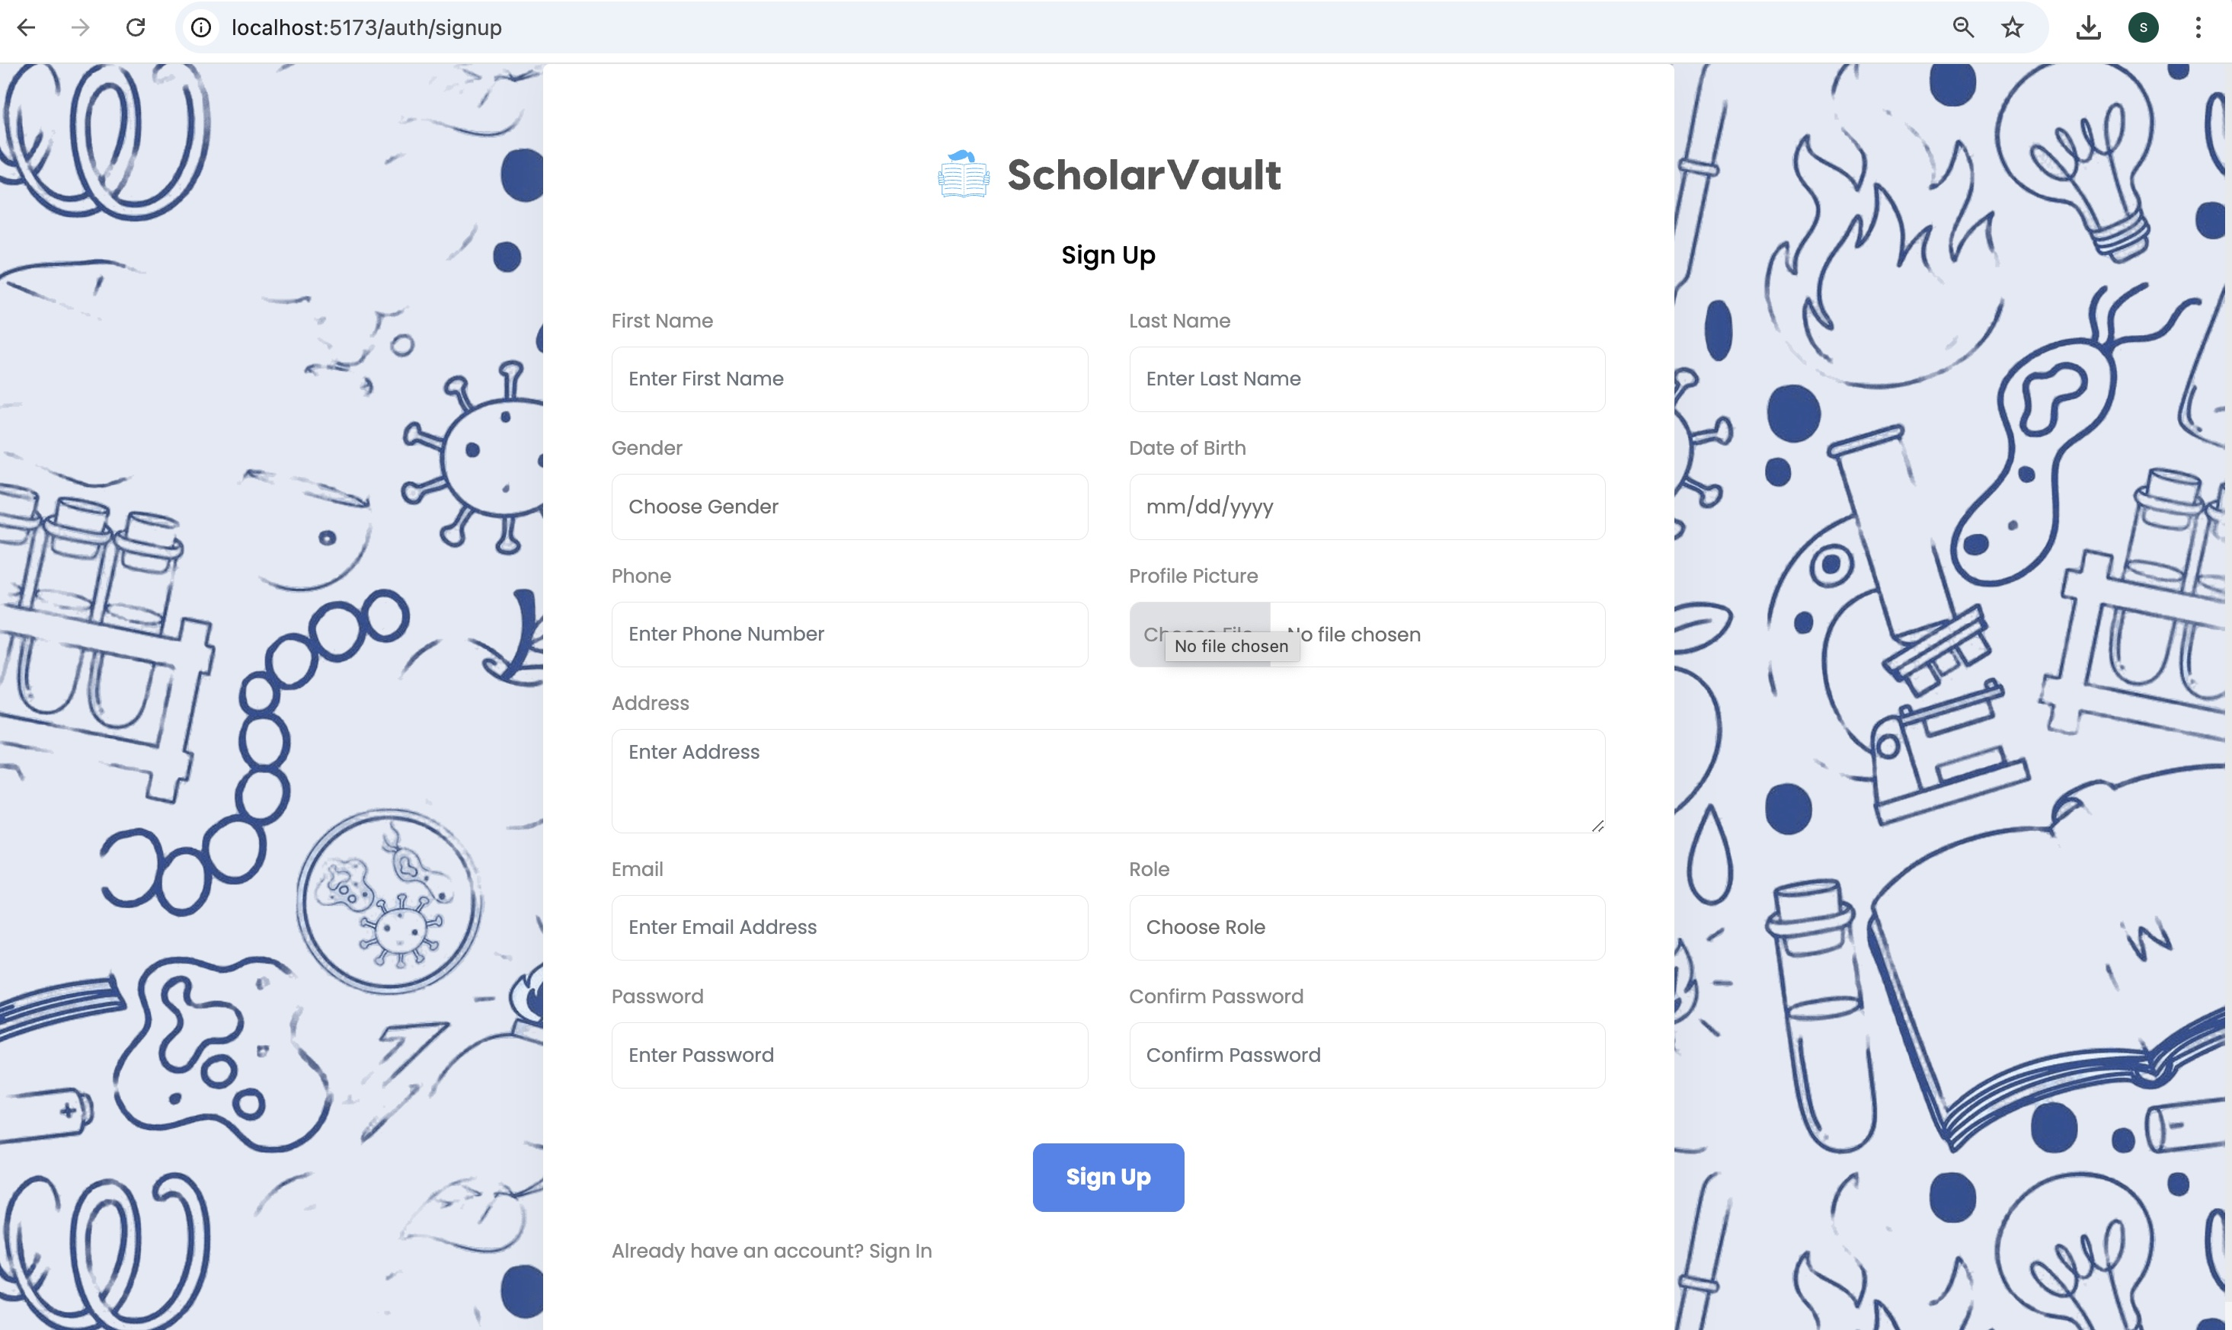
SIGNUP PAGE
New users must first register by providing all the required details through the signup form shown below:

Slide 18
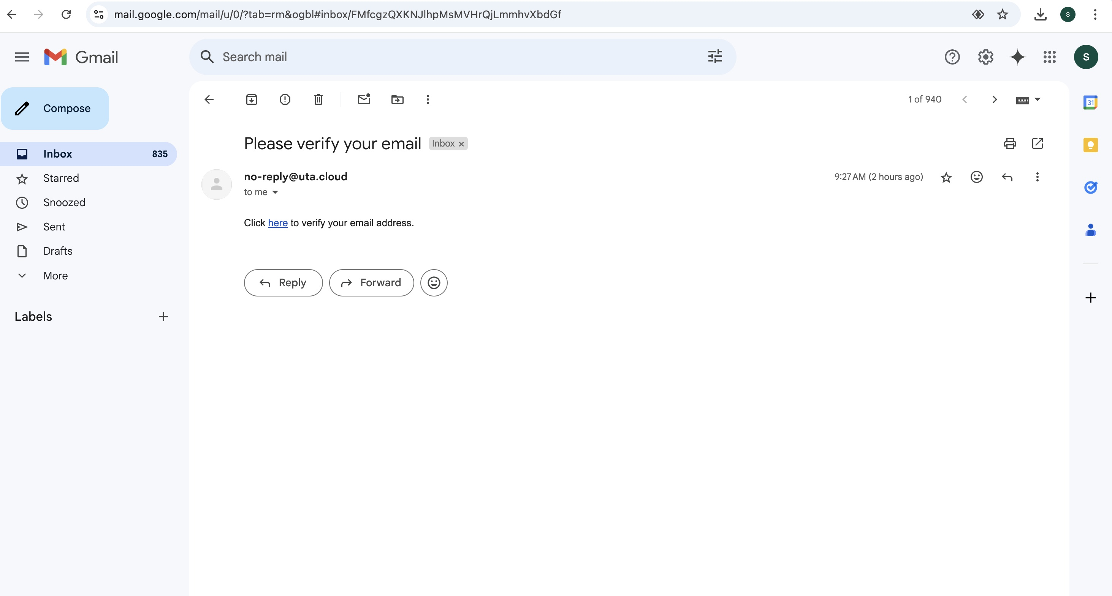
CONFIRMATION PAGE
Once users sign up, a confirmation link is sent to the provided email address to verify their identity, it is known as Email Verification Process.

Slide 19
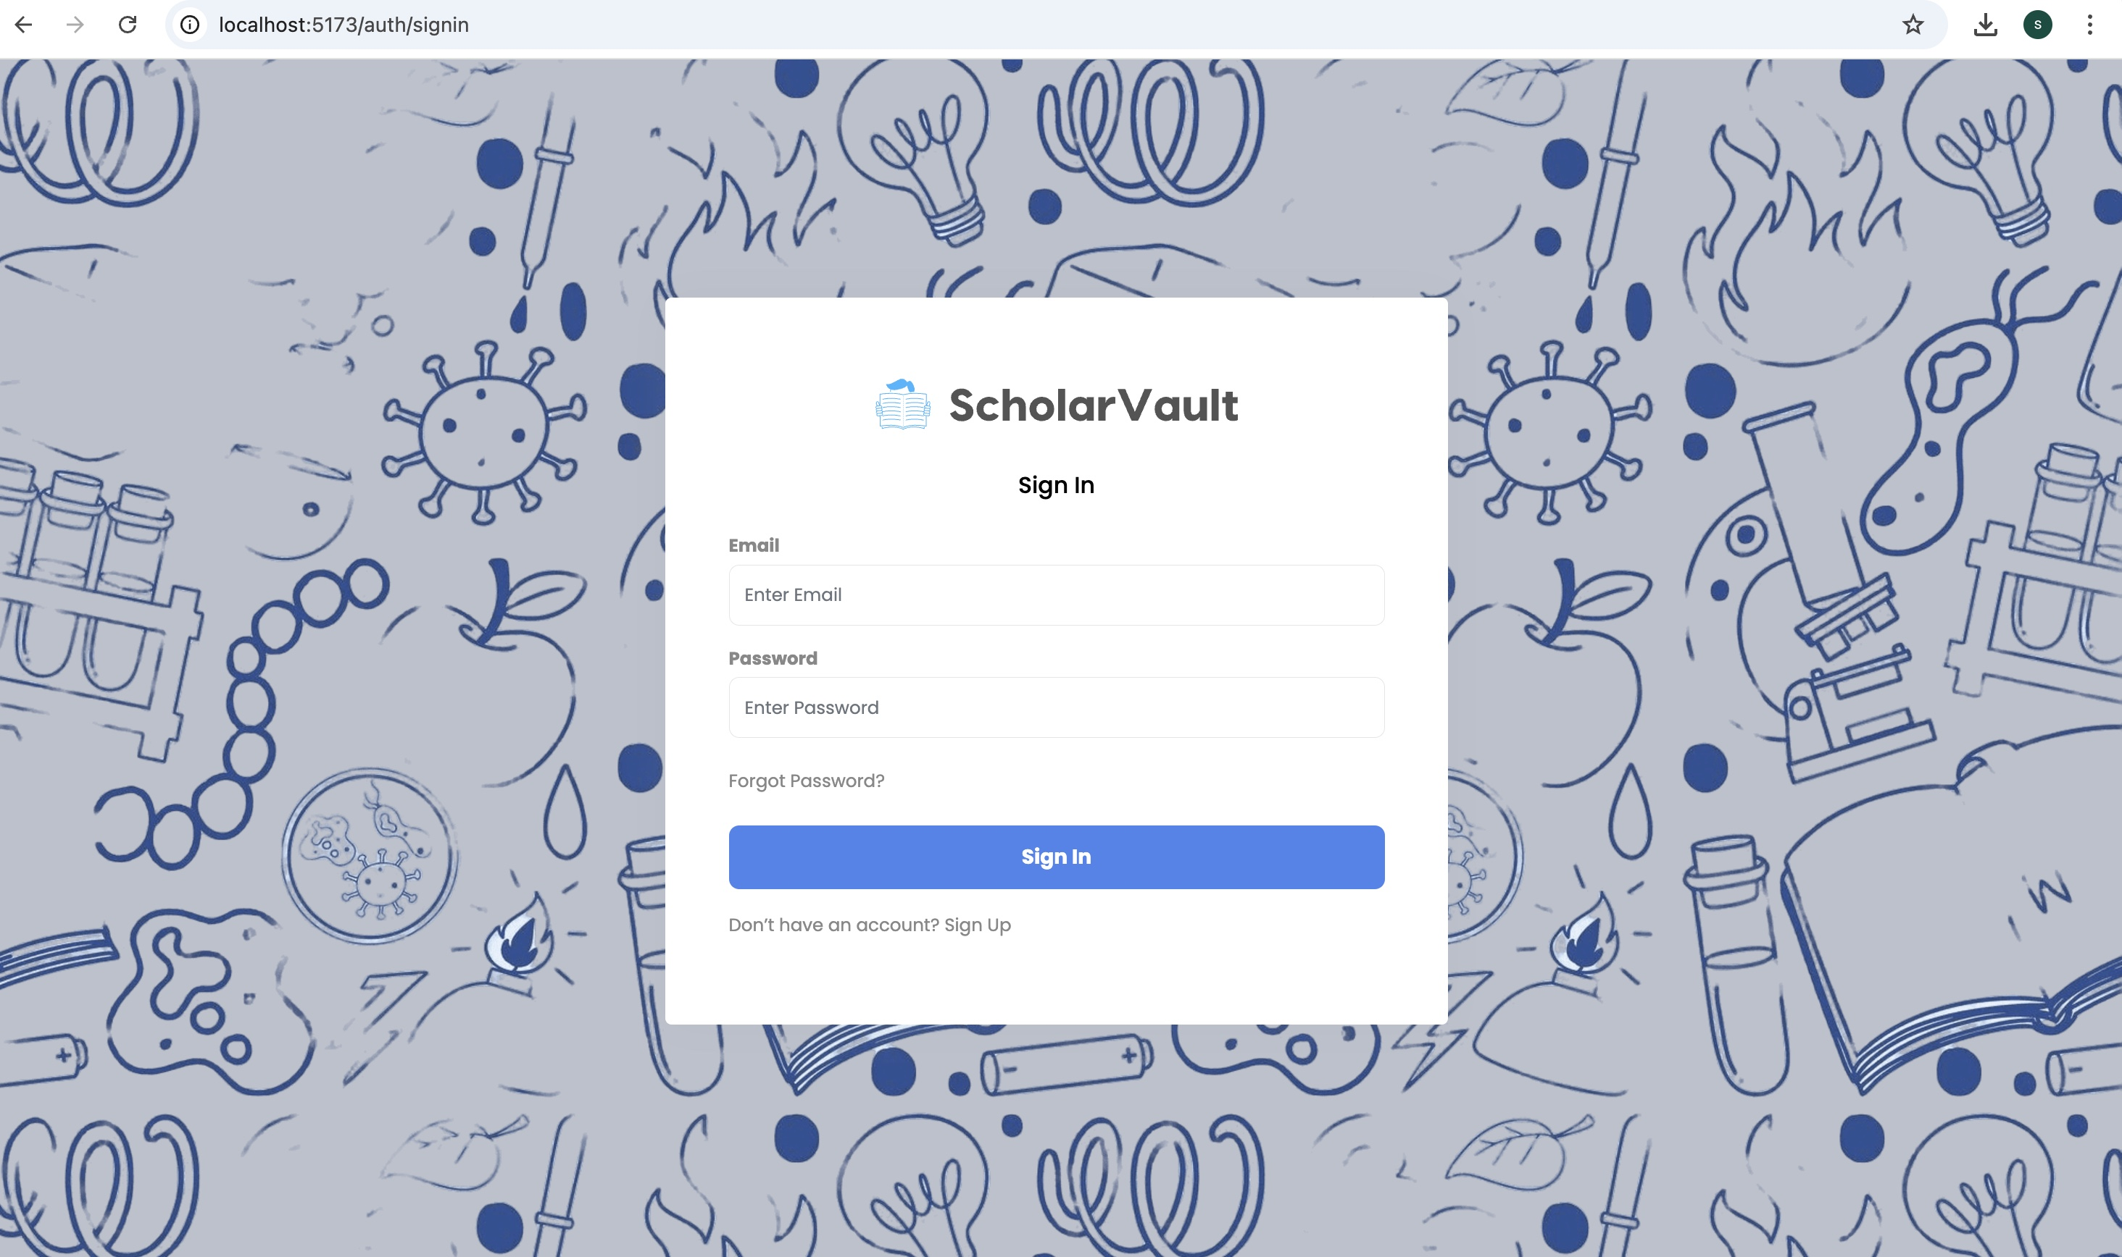
SIGNIN PAGE
After verifying their identity by clicking the confirmation link, the user is redirected to the login page.

Slide 20
ROLES BASED ACCESS CONTROL (RBAC)
Upon successful sign-in, the user is directed to the dashboard.
There are 3 roles for this application:
Admin Role: Granted to administrators with the highest level of access
and control over the application.
Accessible features: Dashboard, All Thesis, Manage Guidelines, Manage Reviews, Manage Users, Manage Thesis, Profile, Chat, Latest Thesis.
2. Scholar Role: Designed for scholars who require access to advanced features for managing and submitting theses.
Accessible features: Dashboard, All Thesis, Manage Guidelines,
Manage Reviews, Manage Thesis, Submit Thesis, Profile, Chat, Latest Thesis.
3. User Role: Designed for general users with basic access permissions to browse and submit content.
Accessible features: Dashboard, All Thesis, Submit Thesis, My Thesis, Profile, Chat, Latest Thesis.

Slide 21
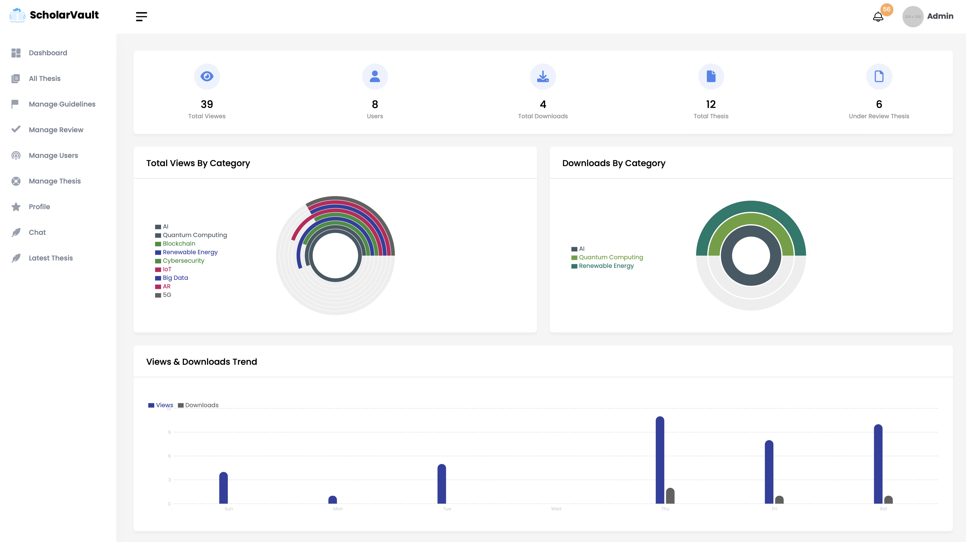
ADMIN HOMEPAGE

Slide 22
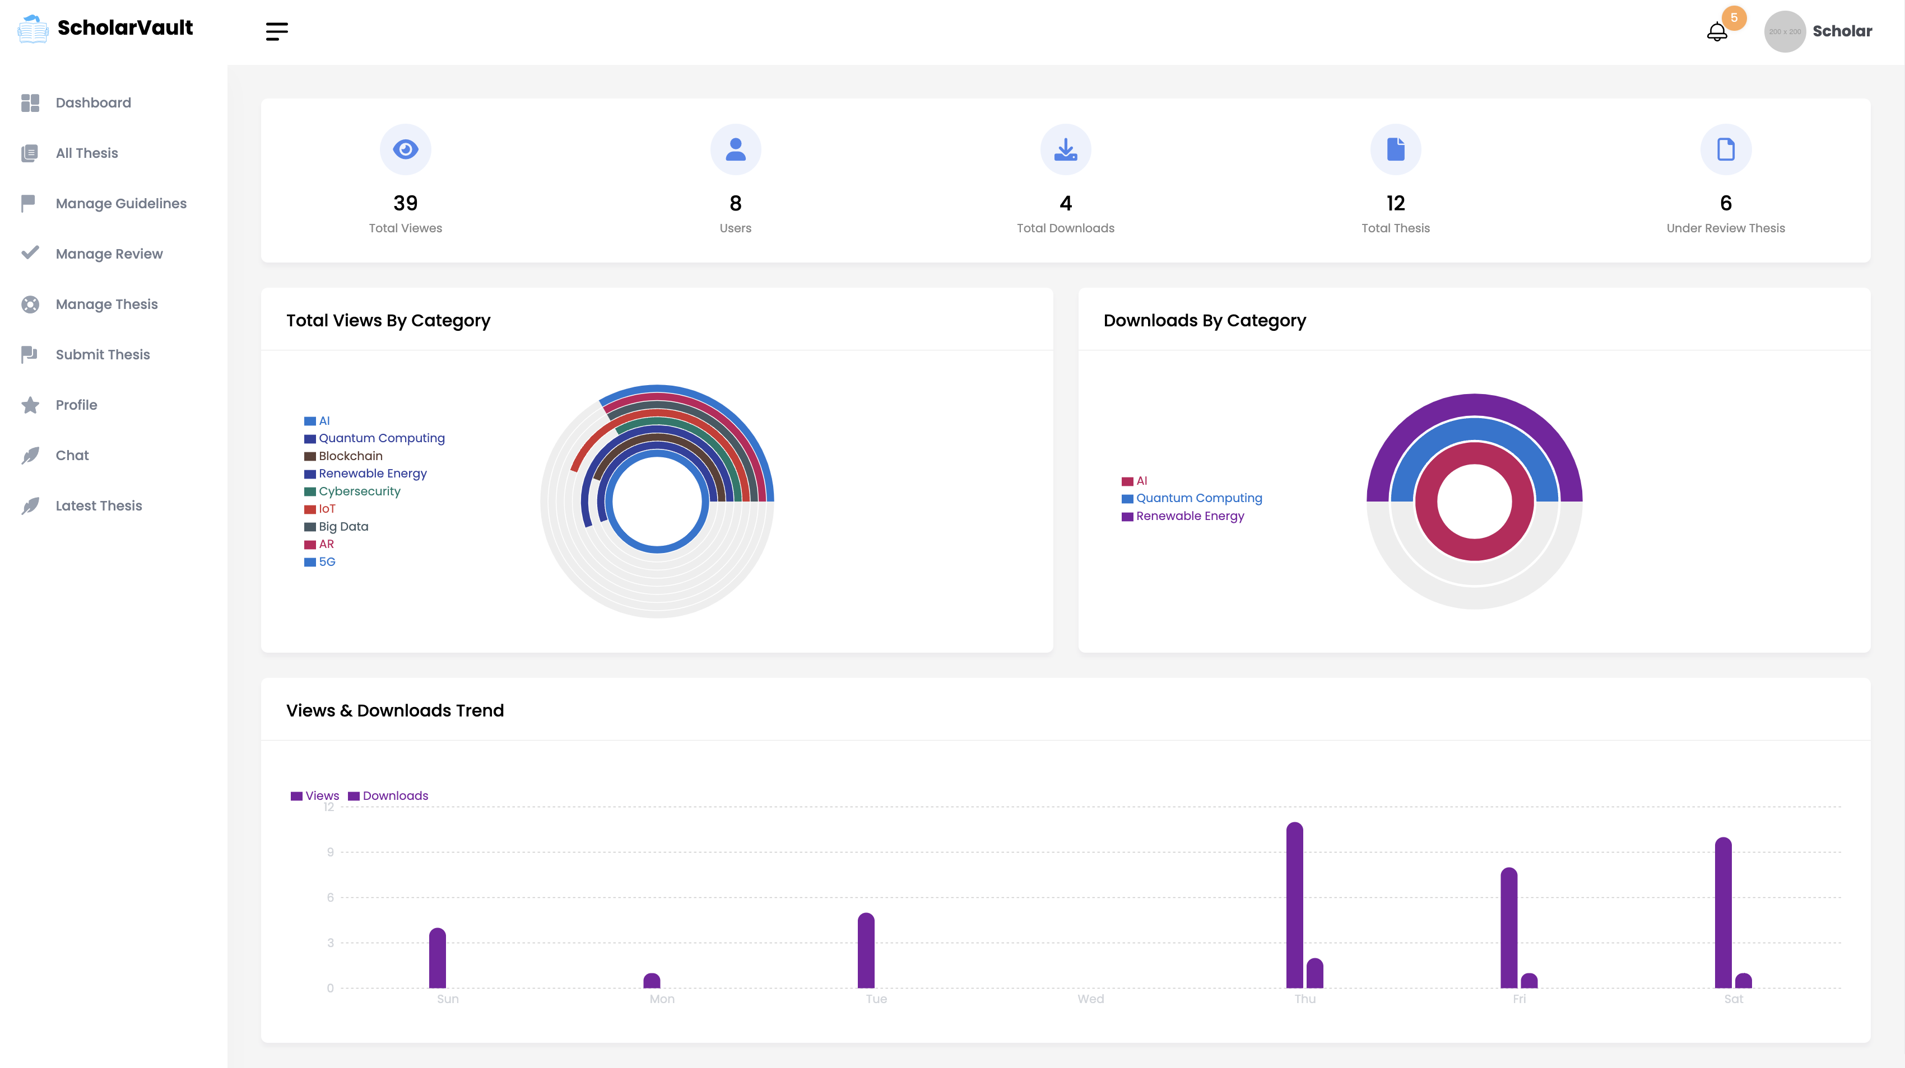
SCHOLAR HOMEPAGE

Slide 23
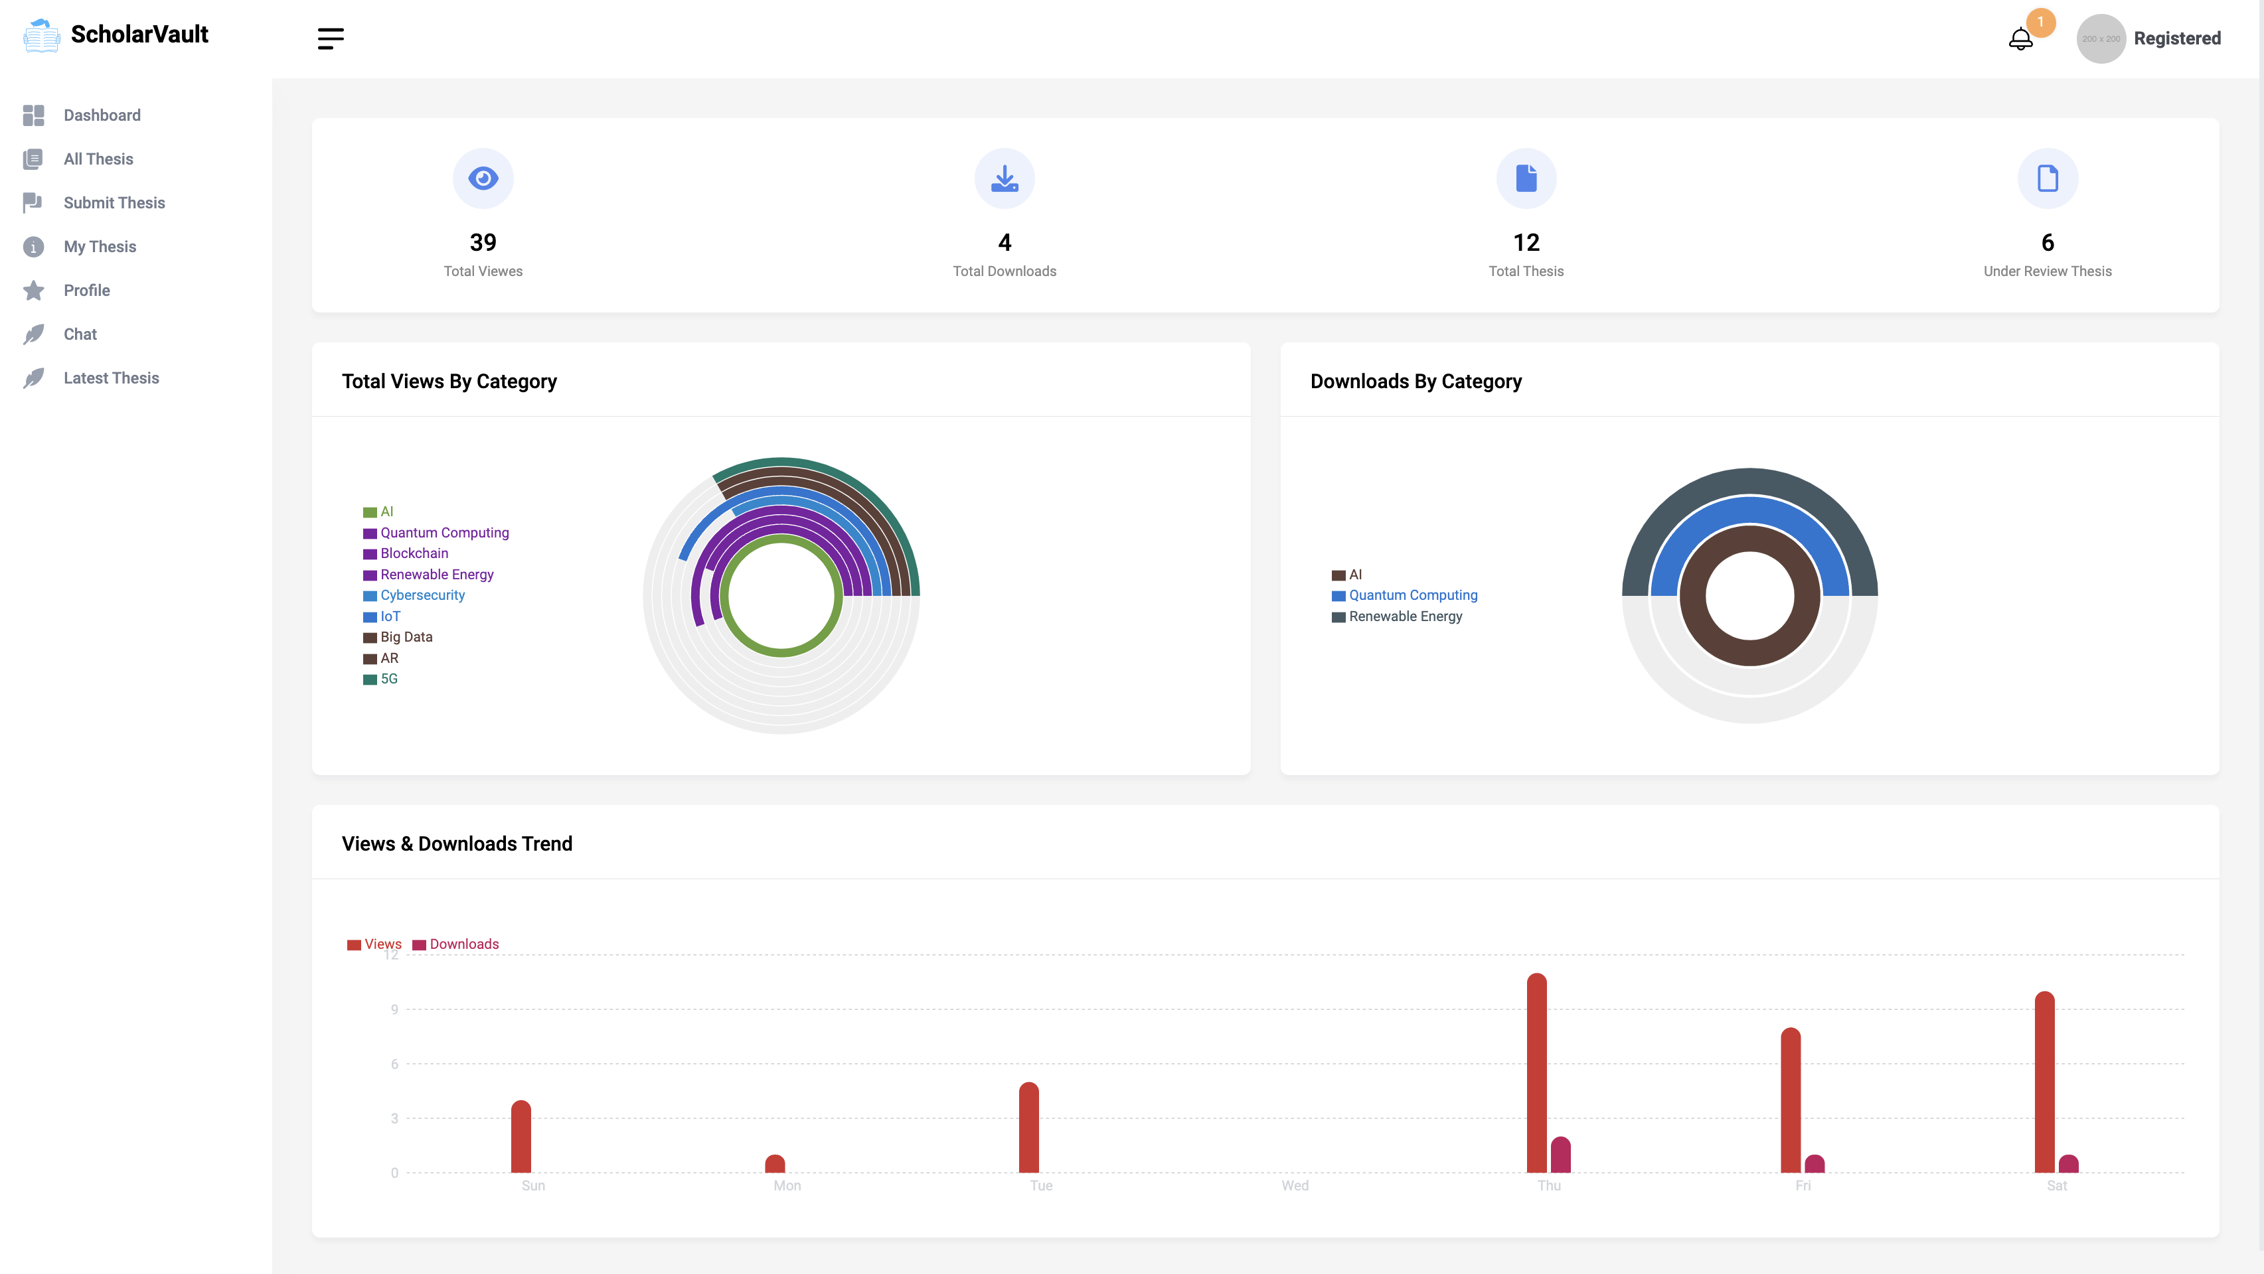
USER HOMEPAGE

Slide 24
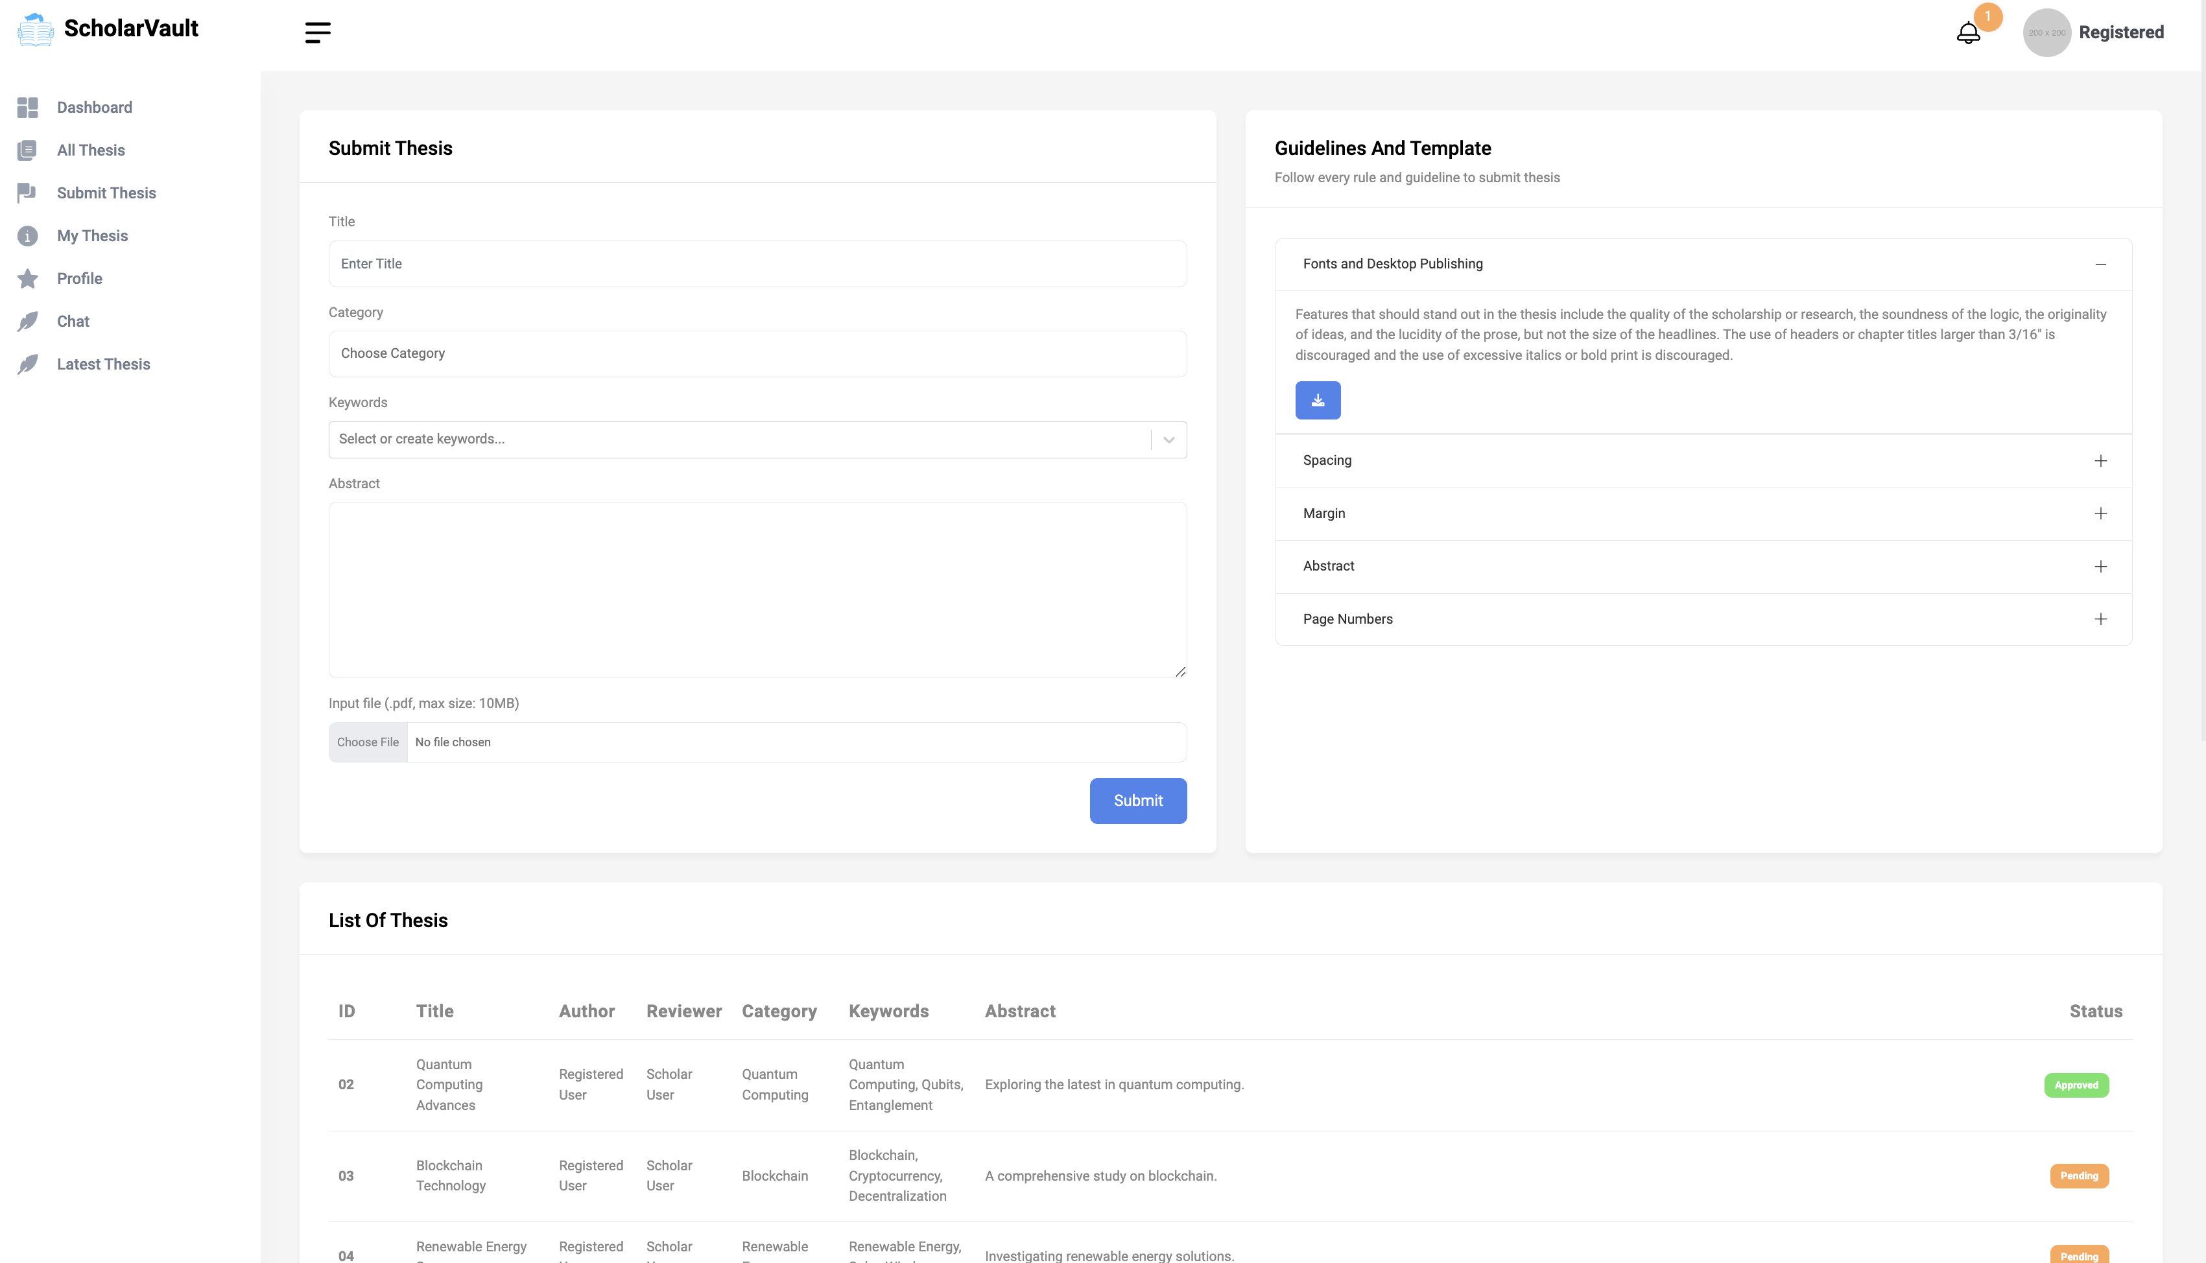
Submit Thesis

Slide 25
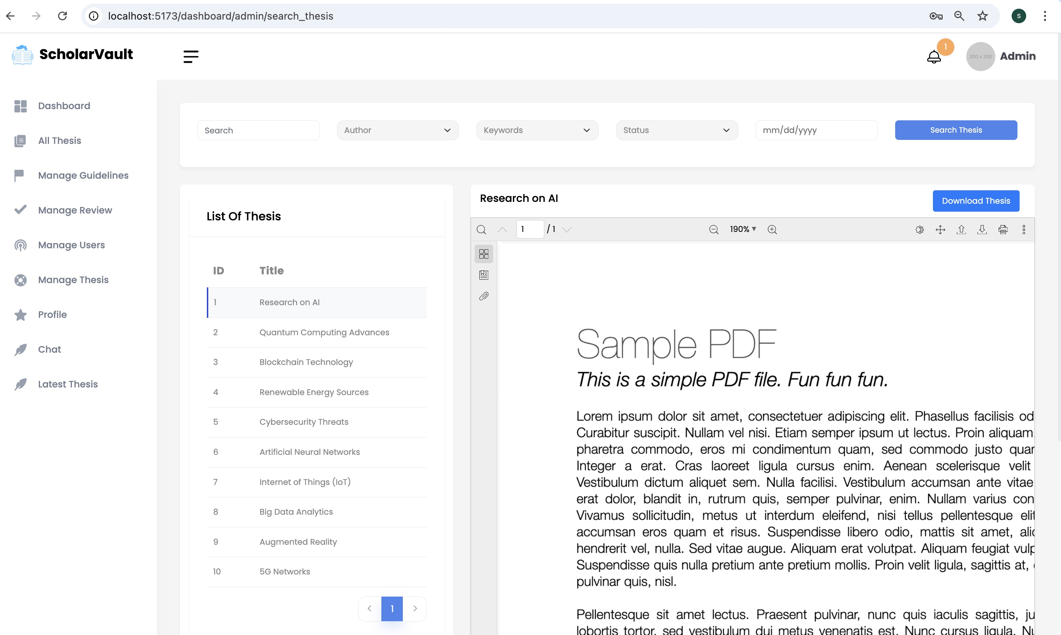
ALL THESIS
This tab displays all the thesis available within the application and includes advanced search features that allow users to find thesis based on various criteria such as title, author, keywords, status, or upload date. It also provides options to preview and download the thesis.
All role-based user can also give comments for the thesis.

Slide 26
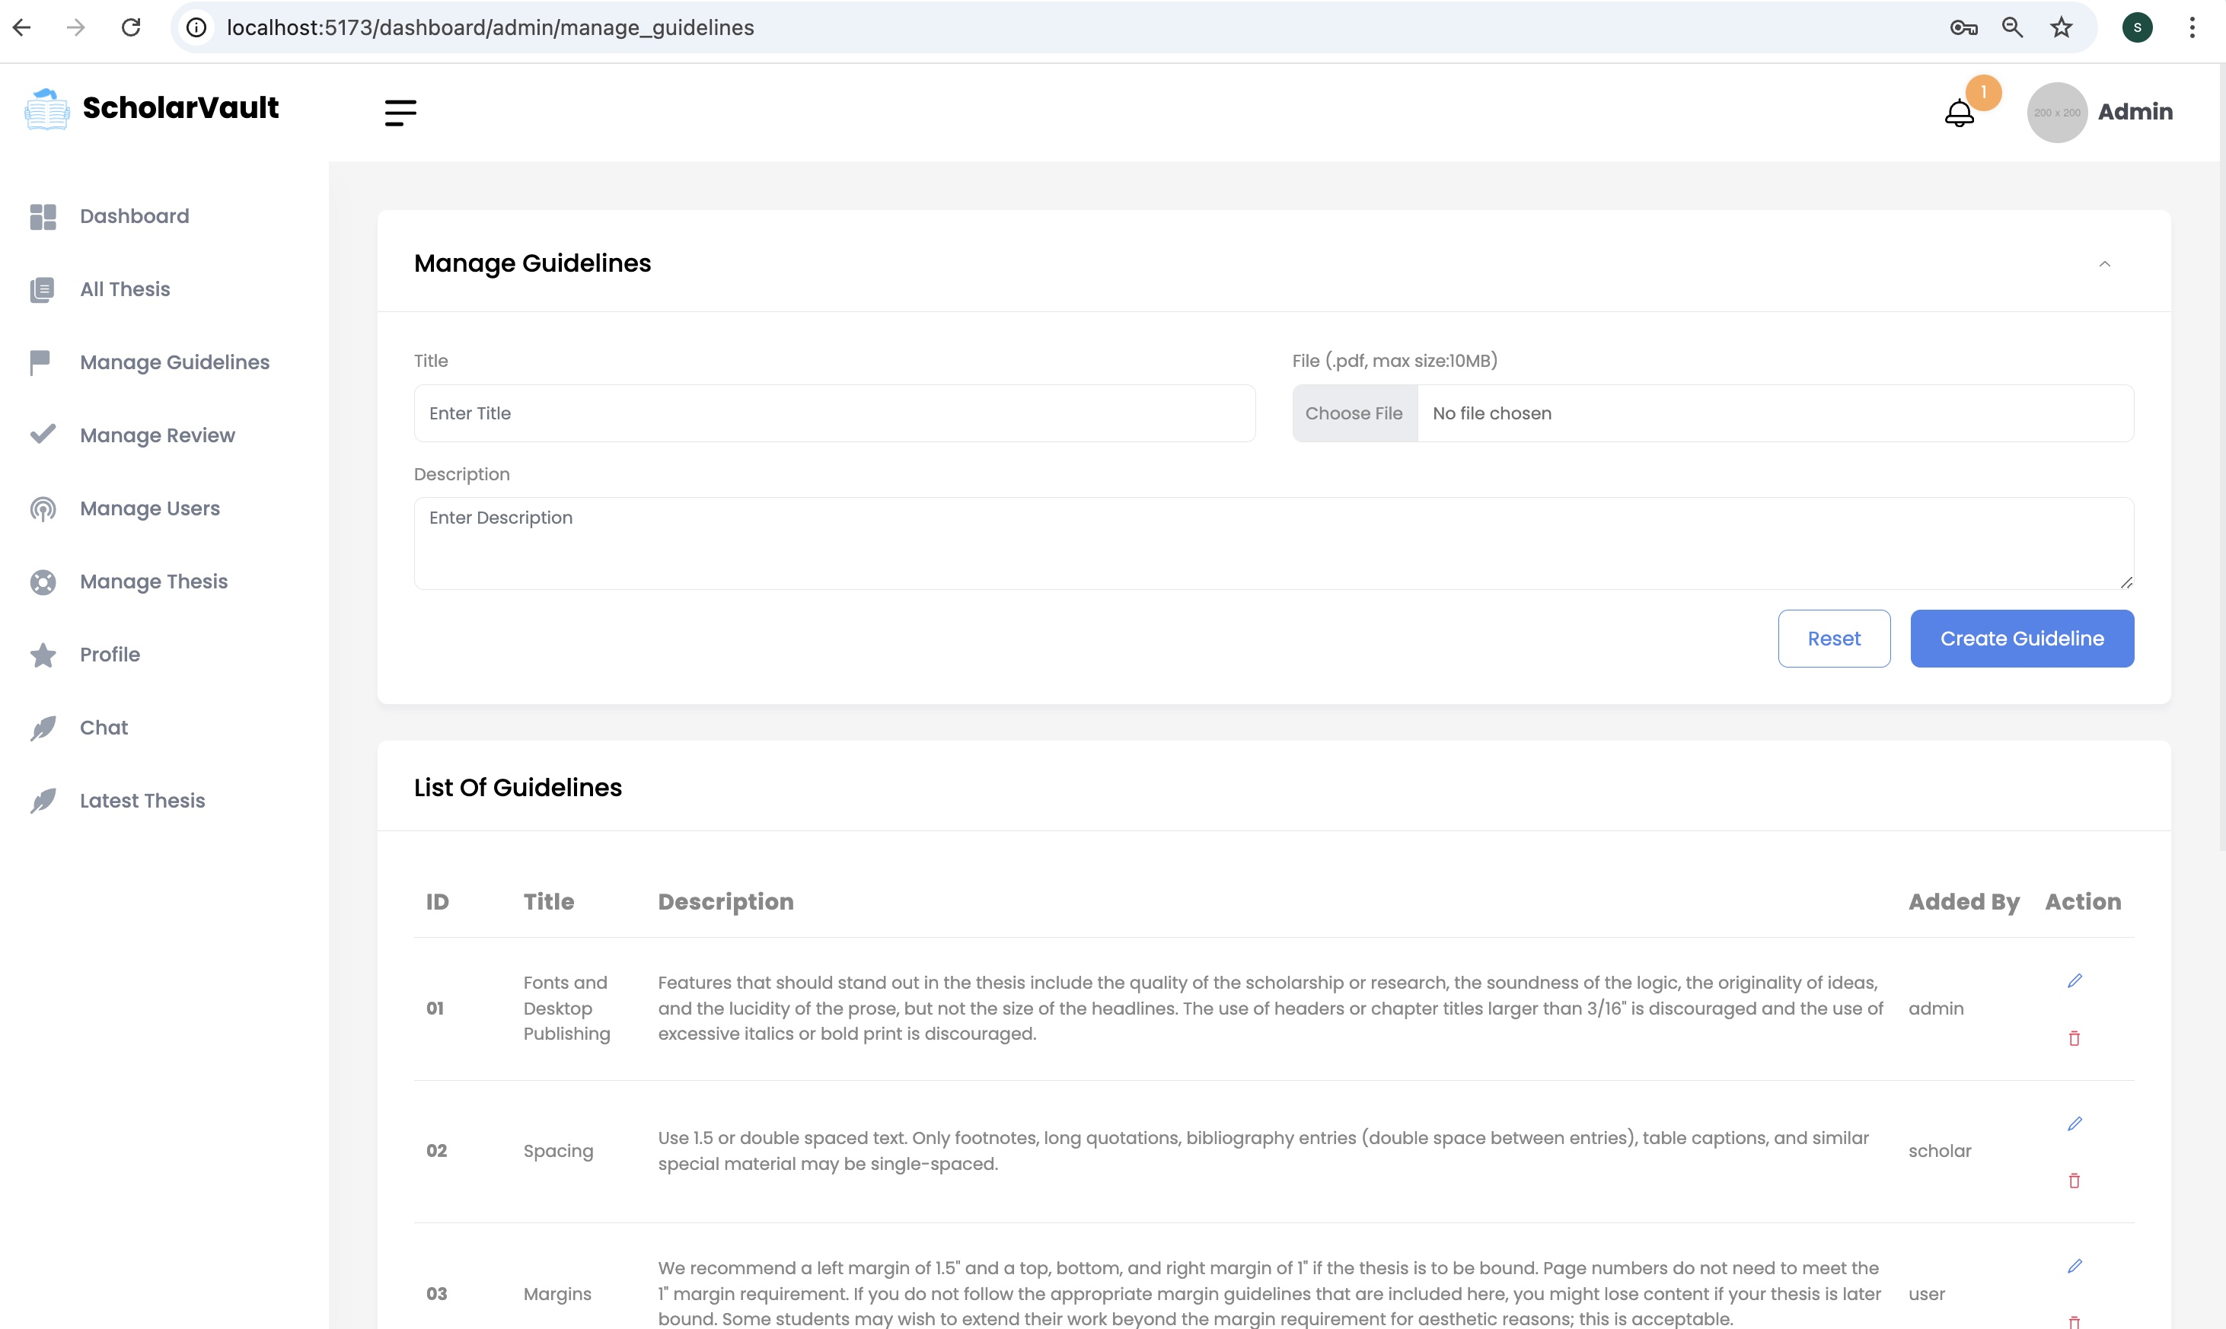
MANAGE GUIDELINES
This tab displays the existing guidelines and provides functionality to add new ones. Admin can also edit or delete existing guidelines as needed. These guidelines will be presented to users during the thesis submission process.

Slide 27
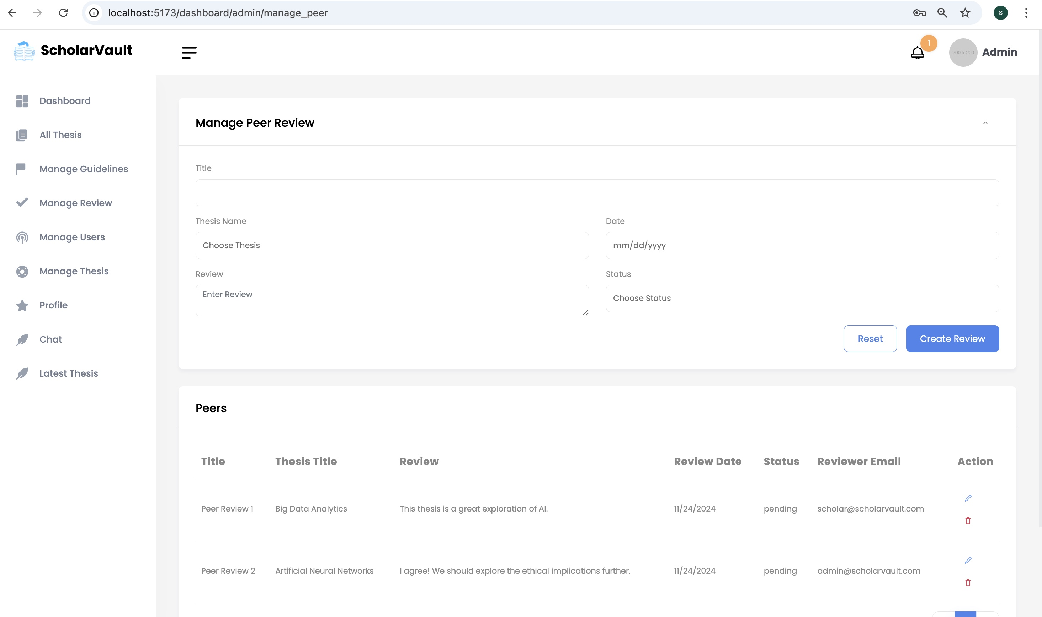
MANAGE PEER REVIEW
Admins and scholars can review existing theses, provide comments, and ensure constructive feedback.
They have the ability to edit or delete reviews for maintaining quality and compliance.

Slide 28
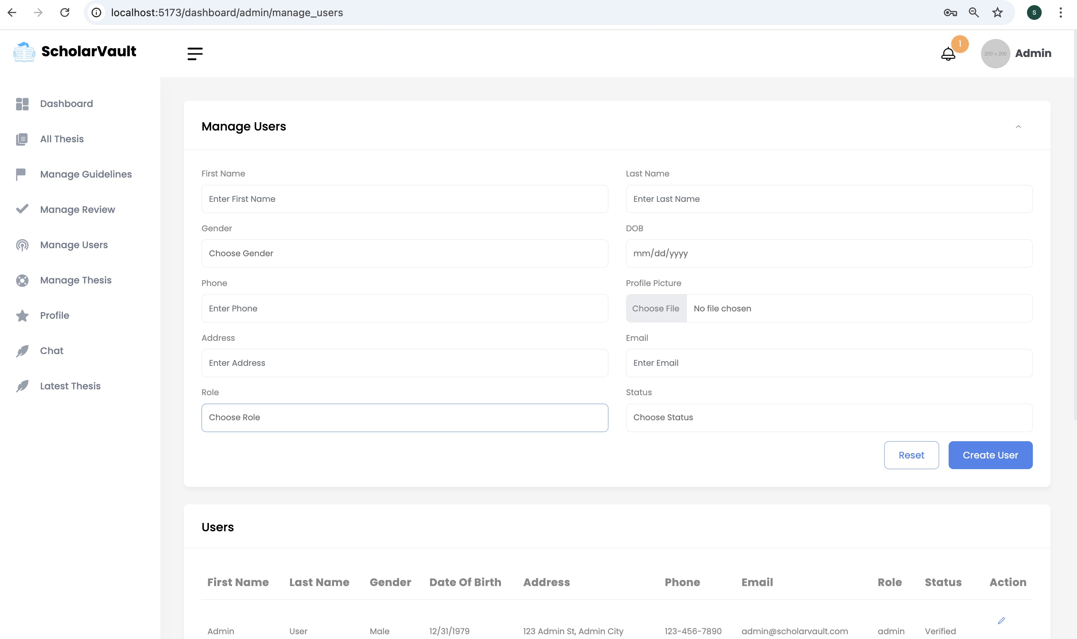
MANAGE USERS
This tab allows the admin to view all registered users, edit their details, and directly create new user accounts.

Slide 29
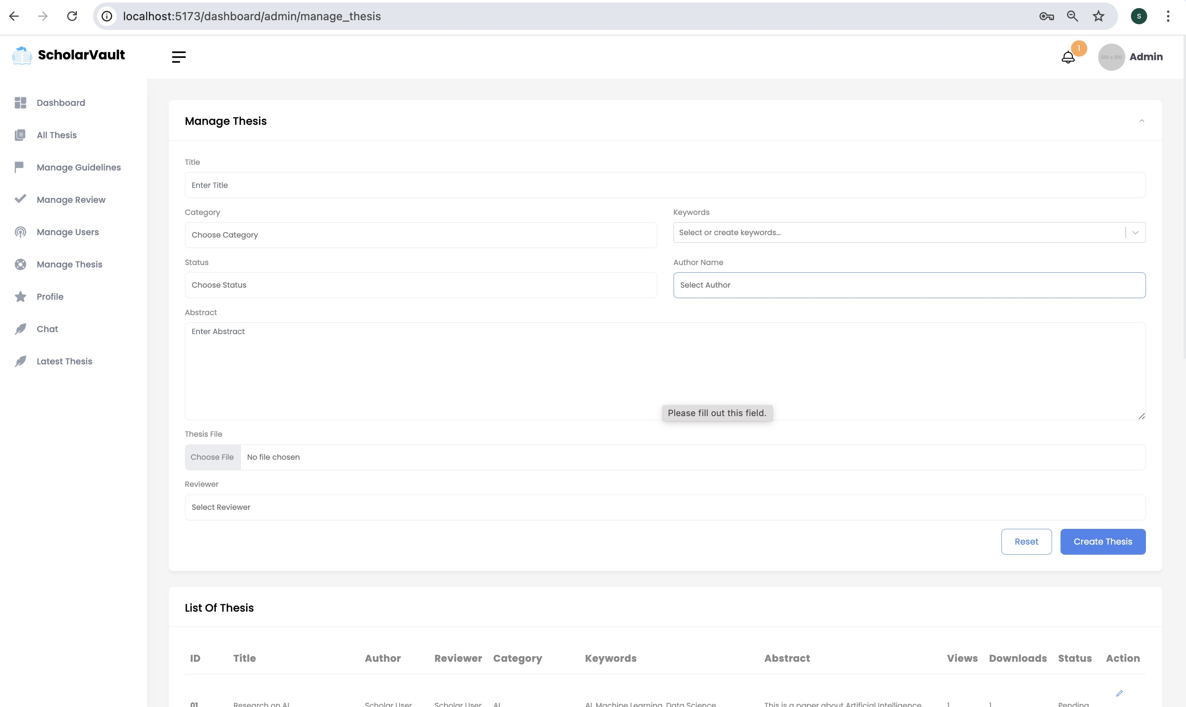
MANAGE THESES
This tab allows the admin to view all registered thesis, edit their details, and also change the status of the thesis.

Slide 30
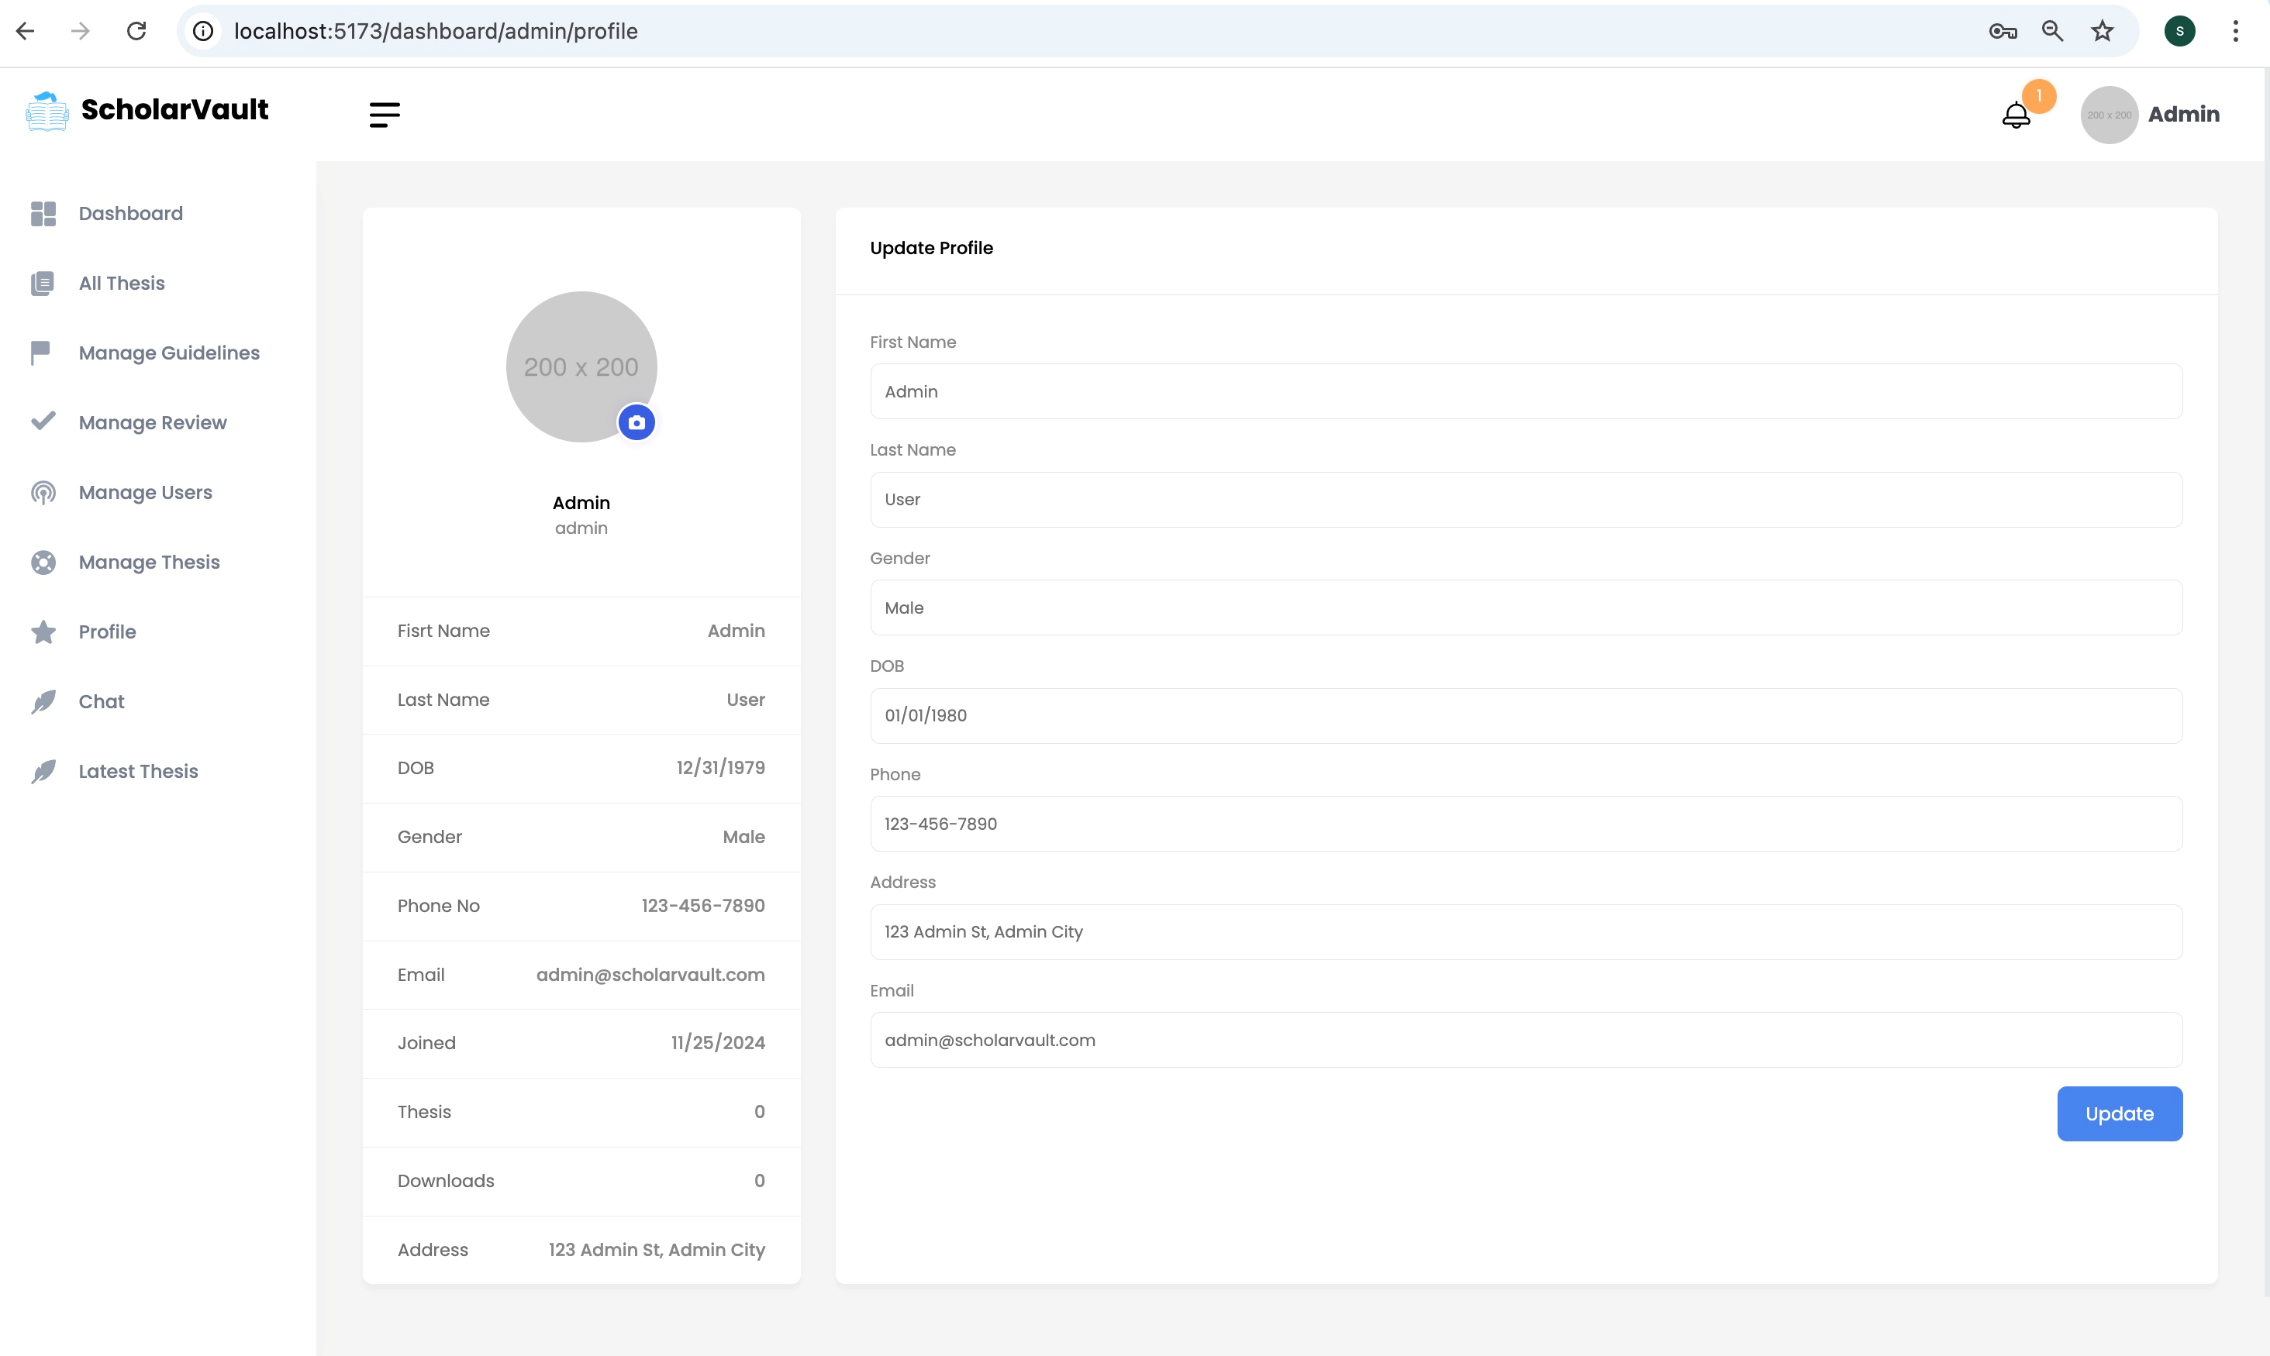
PROFILE
This tab allows the admin to view all registered users, edit their details, and directly create new user accounts.

Slide 31
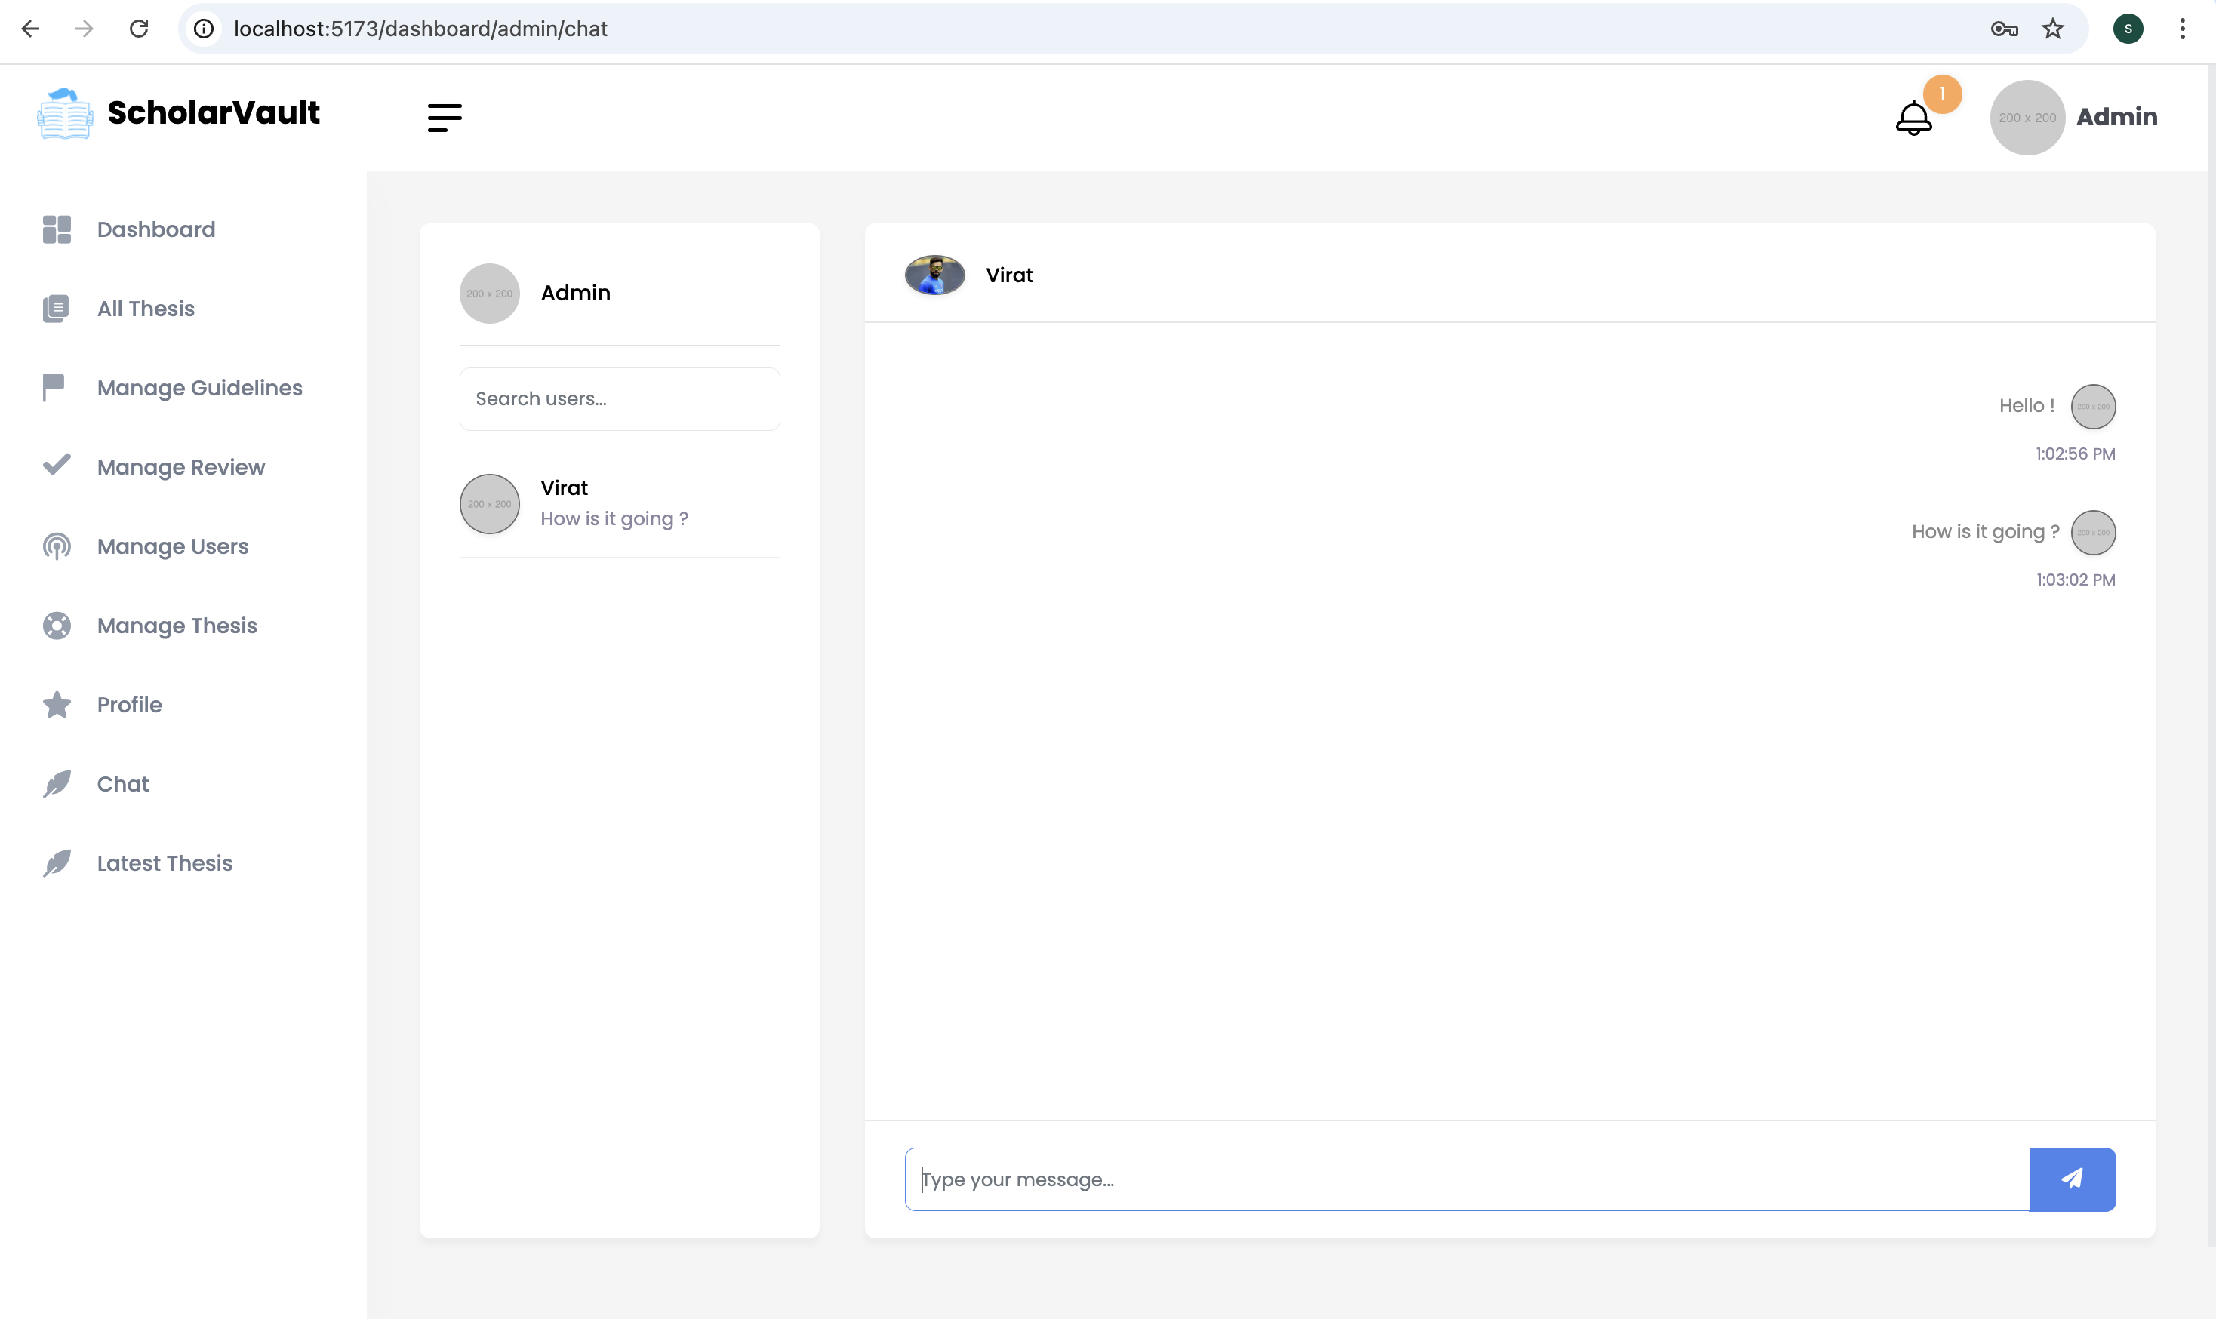
CHAT BOX
All users can chat with other users.

Slide 32
Challenges Faced
React JS Transition: Initially, we built a static site with HTML and CSS. Shifting to React JS was challenging due to our team's novice familiarity with it, but we overcame it through teamwork.
API Development: Building and testing robust APIs for secure and efficient communication between the frontend and backend. Ensuring proper error handling, authentication, and managing API rate limits effectively.
Cloud Deployment and Configuration: In Phase-2, configuring and managing cloud hosting for the frontend was a bit difficult part for us.

Slide 33
Future Scope
Enhanced Notification System for User Queries: Currently, the "Contact Us" page stores user-submitted queries directly in the database. In the future, this functionality can be enhanced by integrating an email notification system. This would ensure that the submitted queries are automatically sent as emails to the relevant team members. By notifying the team in real-time, user issues can be addressed more promptly, improving overall responsiveness and user satisfaction.
Interactive Thesis Preview with Editing Capability: The thesis preview feature can be further expanded to include an option for users to make edits directly during the preview. This would allow users to suggest or implement changes to their theses without navigating away from the preview screen.

Slide 34
Learnings from this Project
Frontend Development: Built responsive and dynamic user interfaces using React with reusable components for scalability.
Backend Development: Developed RESTful APIs using Nextjs
Database Integration: Integrated and managed a database (e.g., MySQL) for efficient data storage and retrieval. Also, we learned query optimization and schema design for better performance.
Frontend-Backend Integration: Connected the frontend with the backend using structured API endpoints for smooth data exchange.
Cloud Deployment: Successfully deployed the frontend on uta.cloud, gaining experience in cloud hosting and DNS management.

Slide 35



